Slide 1

Multiplex technology quantifies functional and actionable microbiota to drive personalised lifestyle interventions to resolve intestinal inflammation.
Resolving chronic intestinal inflammation prevents various diseases.
Environment-host interactions define lifestyle interventions
omega-6 : omega-3 ratio
diversity and abundance of microbiota
dysbiosis index (microbiota disbalance score)
Resolve inflammation
Finding cause of inflammation

Slide 2






resolving inflammation
Intestinal inflammation
  Measure microbiota and lipid profile to find the cause
  Utilise Lifestyle interventions to restore Gut Health
Microbiota
Lifestyle interventions to regain intestinal function
  nutrition
  stress management
  physical activity
  substance use
  environmental exposure
  sleep
  sexual health and fertility
Lipid balance
Lifestyle
interventions

Slide 3
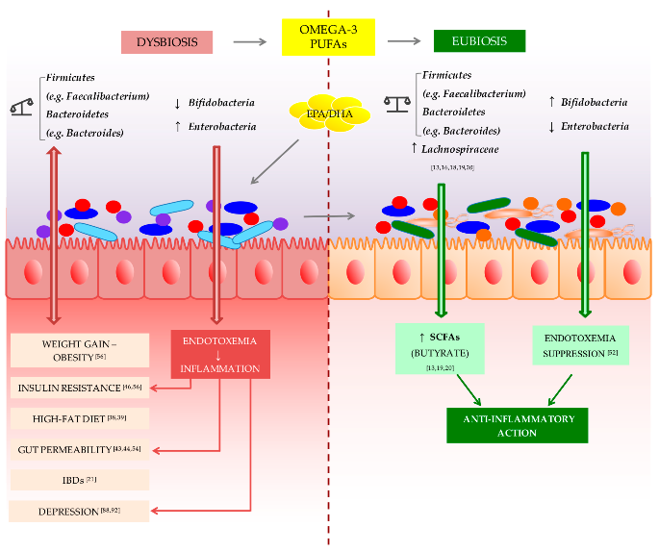
Dysbiosis
imbalance of gut microbiota (bacteria)
Chronic inflammation
activation of immune cells and the release of pro-inflammatory mediators
Lifestyle interventions
Omega-3 polyunsaturated fatty acid (PUFA) restores Firmicutes/Bacteroidetes ratio
Notes:
Dysbiosis is an imbalance of gut microbiota (bacteria) associated with weight gain, obesity, insulin resistance, leaky gut, inflammatory bowel disease (IBD) and depression. Omega-3 polyunsaturated fatty acid (PUFA) are able to reverse this condition by restoring the proper bacterial type balance (Firmicutes/Bacteroidetes ratio) resulting in increased production of the anti-inflammatory short-chain fatty acid (SCFA) butyrate. Omega-3 PUFAs can be considered as prebiotics, able to restore gut bacterial balance (eubiosis) in some pathological condition.
Short-chain fatty acids (SCFAs) are produced by the fermentation of dietary fiber by gut bacteria, particularly members of the Firmicutes and Bacteroidetes phyla. SCFAs, such as acetate, propionate, and butyrate, have been shown to have anti-inflammatory effects and play a critical role in the resolution of inflammation.
When the gut microbiota is in a state of dysbiosis (i.e., an imbalance in the microbial community), the production of SCFAs may be decreased. This can lead to a variety of negative health outcomes, including inflammation. Inflammation is a complex biological response to harmful stimuli, such as infection or tissue damage, and is characterized by the activation of immune cells and the release of pro-inflammatory mediators.
SCFAs can modulate the activity of immune cells and reduce the production of pro-inflammatory cytokines, such as TNF-alpha, IL-6, and IL-1β. SCFAs can also induce the production of anti-inflammatory cytokines, such as IL-10, which helps to resolve inflammation. Additionally, SCFAs can regulate the activity of regulatory T cells, which are essential for maintaining immune homeostasis and preventing autoimmune diseases.
Overall, SCFAs play a crucial role in maintaining gut health and modulating immune responses. The decrease in SCFA production due to dysbiosis can contribute to the development of chronic inflammation and other negative health outcomes. Therefore, promoting the growth of beneficial gut bacteria that produce SCFAs through a healthy diet and probiotic supplementation may be an effective strategy for promoting inflammation resolution and overall health.
Intestinal microbiota might also positively influence immune responses, and protect against the development of inflammatory diseases^{1,2}. One of these elements may be short-chain fatty acids (SCFAs), which are produced by fermentation of dietary fibre by intestinal microbiota. A feature of human ulcerative colitis and other colitic diseases is a change in ‘healthy’ microbiota such as Bifidobacterium and Bacteriodes³, and a concurrent reduction in SCFAs⁴. Moreover, increased intake of fermentable dietary fibre, or SCFAs, seems to be clinically beneficial in the treatment of colitis⁵⁻⁹. SCFAs bind the G-protein-coupled receptor 43 (GPR43, also known as FFAR2)^{10,11}, and here we show that SCFA–GPR43 interactions profoundly affect inflammatory responses. Stimulation of GPR43 by SCFAs was necessary for the normal resolution of certain inflammatory responses, because GPR43-deficient (Gpr43^{−/−}) mice showed exacerbated or unresolving inflammation in models of colitis, arthritis and asthma. https://www.ncbi.nlm.nih.gov/pmc/articles/PMC3256734/
More in-depth studies highlight a different impact on disease pathogenesis of different types of fats; particular attention has been paid to the different role of ω-3 and ω-6 polyunsaturated essential fatty acids (PUFA) with several studies demonstrating that ω-3 PUFA is anti-inflammatory, whereas ω-6 PUFA is pro-inflammatory and a balanced ratio of ω-3 to ω-6 PUFA is essential for homeostasis [103]. Indeed, Western diets usually involve a high ω-6 to ω-3 ratio, leading to a greater probability of developing IBD [101,104]. Power, S., O'Toole, P., Stanton, C., Ross, R., & Fitzgerald, G. (2014). Intestinal microbiota, diet and health. British Journal of Nutrition, 111(3), 387-402. doi:10.1017/S0007114513002560
Figure taken from Int. J. Mol. Sci. 2017, 18(12), 2645; https://doi.org/10.3390/ijms18122645

Slide 4
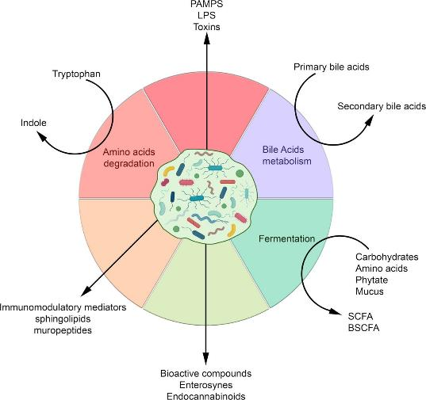
Dysbiosis
imbalance of gut microbiota (bacteria) resulting in negative health outcomes
Metabolites
anti-inflammatory short-chain fatty acid (SCFA)
neurotransmitters
hormone elimination / recirculation
Notes:
When the gut microbiota is in a state of dysbiosis (i.e., an imbalance in the microbial community), the production of SCFAs may be decreased. This can lead to a variety of negative health outcomes, including inflammation. Inflammation is a complex biological response to harmful stimuli, such as infection or tissue damage, and is characterized by the activation of immune cells and the release of pro-inflammatory mediators.
SCFAs can modulate the activity of immune cells and reduce the production of pro-inflammatory cytokines, such as TNF-alpha, IL-6, and IL-1β. SCFAs can also induce the production of anti-inflammatory cytokines, such as IL-10, which helps to resolve inflammation. Additionally, SCFAs can regulate the activity of regulatory T cells, which are essential for maintaining immune homeostasis and preventing autoimmune diseases.
Overall, SCFAs play a crucial role in maintaining gut health and modulating immune responses. The decrease in SCFA production due to dysbiosis can contribute to the development of chronic inflammation and other negative health outcomes. Therefore, promoting the growth of beneficial gut bacteria that produce SCFAs through a healthy diet and probiotic supplementation may be an effective strategy for promoting inflammation resolution and overall health.
Intestinal microbiota might also positively influence immune responses, and protect against the development of inflammatory diseases^{1,2}. One of these elements may be short-chain fatty acids (SCFAs), which are produced by fermentation of dietary fibre by intestinal microbiota. A feature of human ulcerative colitis and other colitic diseases is a change in ‘healthy’ microbiota such as Bifidobacterium and Bacteriodes³, and a concurrent reduction in SCFAs⁴. Moreover, increased intake of fermentable dietary fibre, or SCFAs, seems to be clinically beneficial in the treatment of colitis⁵⁻⁹. SCFAs bind the G-protein-coupled receptor 43 (GPR43, also known as FFAR2)^{10,11}, and here we show that SCFA–GPR43 interactions profoundly affect inflammatory responses. Stimulation of GPR43 by SCFAs was necessary for the normal resolution of certain inflammatory responses, because GPR43-deficient (Gpr43^{−/−}) mice showed exacerbated or unresolving inflammation in models of colitis, arthritis and asthma. https://www.ncbi.nlm.nih.gov/pmc/articles/PMC3256734/
More in-depth studies highlight a different impact on disease pathogenesis of different types of fats; particular attention has been paid to the different role of ω-3 and ω-6 polyunsaturated essential fatty acids (PUFA) with several studies demonstrating that ω-3 PUFA is anti-inflammatory, whereas ω-6 PUFA is pro-inflammatory and a balanced ratio of ω-3 to ω-6 PUFA is essential for homeostasis [103]. Indeed, Western diets usually involve a high ω-6 to ω-3 ratio, leading to a greater probability of developing IBD [101,104]. Power, S., O'Toole, P., Stanton, C., Ross, R., & Fitzgerald, G. (2014). Intestinal microbiota, diet and health. British Journal of Nutrition, 111(3), 387-402. doi:10.1017/S0007114513002560
Figure taken from Int. J. Mol. Sci. 2017, 18(12), 2645; https://doi.org/10.3390/ijms18122645

Slide 5


What is your gut telling you?
The human body consist of 50 % human cells and 50 % bacterial cells. 95% of your bacteria are located in the large intestine.
Dysbiosis test
IBS
Diabetes
A microbiota profile
part of the Gut Restore Program
Auto-immune deceases
Parkinson
IBD
Cancer
Depression
Obesity
Autism
Notes:
When the balance of gut micro- biota is disturbed, the intestinal mucosa becomes inflamed and deteriorate. It can induce (or “thus the risk”) many inflam- matory diseases. Such ones as, obesity, chronic fatigue, Crohn’s disease, allergies, cancers, as well as mental illnesses such
as anxiety, depression, Parkin- son’s disease, Alzheimer’s and migraines, all of them can be triggered by disruption of gut microbial equilibrium.

Slide 6
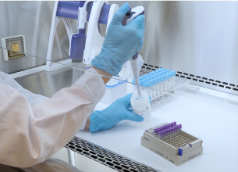
Intended Use
Identify
    Qualitative; non-dysbiostic / dysbiotic
    Diversity; Alpha diversity (Shannon Index)
    Dysbiosis Index (DI) scale from 1-5; severity of dysbiosis
    Characterize
    Functional bacteria profiles; characterize bacteria functionality
    Microbiota profile; abundance score for 48 selected bacteria markers
Dysbiosis test
A microbiota profile
part of the Gut Restore Program

Slide 7
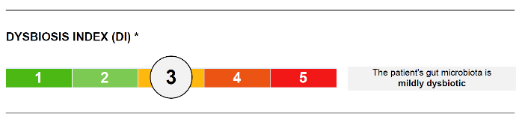
  Non-dysbiotic/dysbiotic
  Dysbiosis Index scale from 1-5; non-dysbiotic, mild dysbiosis or more severe dysbiosis
  Higher DI = bacteria composition further away from the normal reference
      Healthy: 16% dysbiotic¹
      Irritable bowel syndrome (IBS): 70% dysbiotic¹
      Inflammatory bowel disease (IBD): 70-80% dysbiotic¹. More common with severe dysbiosis.
Dysbiosis test
A microbiota profile
part of the Gut Restore Program
1) Casén C, et al. “Deviations in human gut microbiota: a novel diagnostic test for determining dysbiosis in patients with IBS or IBD.” Aliment Pharmacol Ther (2015).

Slide 8
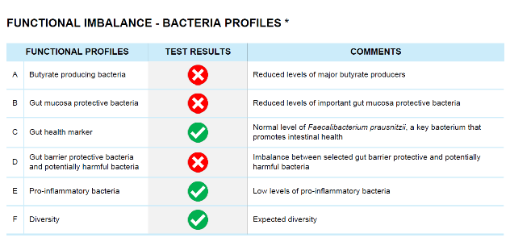
Functional bacteria profiles
Dysbiosis test
A microbiota profile
part of the Gut Restore Program
  Functional bacteria profiles
  Indicated as balanced (green) or imbalanced (red)
  Imbalance criteria based on bacteria abundance scores

Slide 9
Functional bacteria profiles
  Selected bacteria markers and associated functions
Functional bacteria profiles | Bacteria marker
Butyrate producing bacteria | Anaerobutyricum hallii [Eubacterium] rectale Faecalibacterium prausnitzii
Gut mucosa protective bacteria | Faecalibacterium prausnitzii Akkermansia muciniphila
Gut health marker | Faecalibacterium prausnitzii
Gut barrier protective bacteria and potentially harmful bacteria | Faecalibacterium prausnitzii Ruminococcus gnavus Proteobacteria Shigella spp./Escherichia spp.
Pro-inflammatory bacteria | Proteobacteria Shigella spp./ Escherichia spp.
Dysbiosis test
A microbiota profile
part of the Gut Restore Program

Slide 10
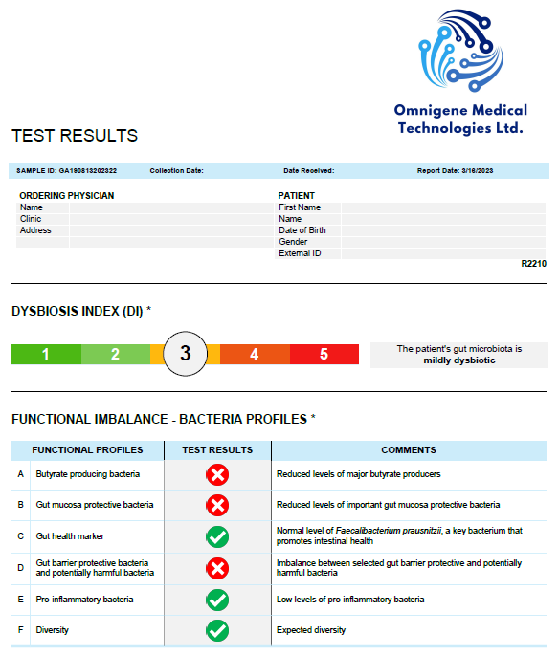
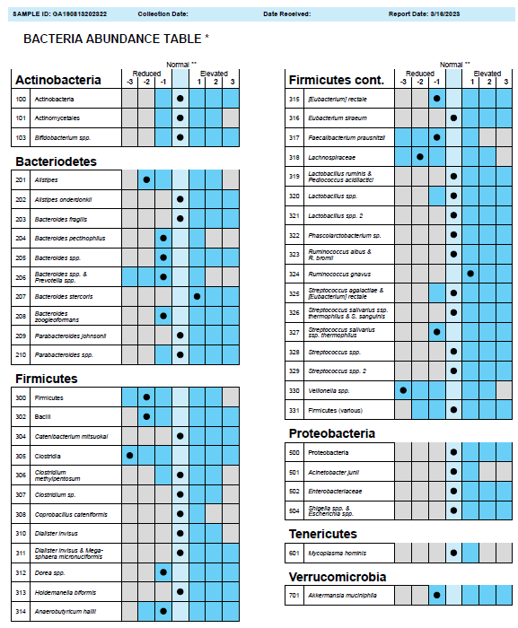

Slide 11
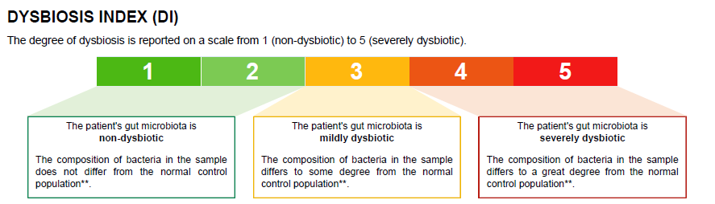
Clinical studies report that among a healthy population 16% of individuals have a mild dysbiosis (DI 3).
Individuals with irritable bowel syndrome (IBS) 70-80% have a microbiota profile that falls outside of the normal range (DI > 2).
Inflammatory Bowel Disease (IBD) patients tend to have a more severe dysbiosis (DI 4-5).

Slide 12
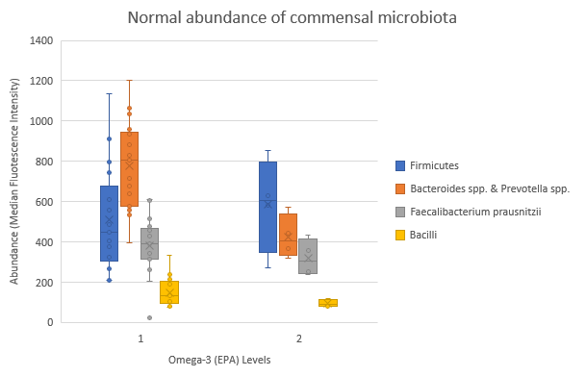
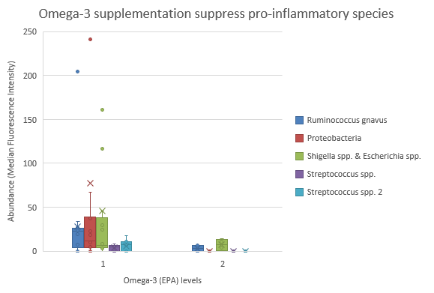
1: Eicosapentaenoic acid (EPA) lower than normal range (prior to omega-3 intervention)
2: Eicosapentaenoic acid (EPA) within normal range (after omega-3 intervention)

Slide 13
Line Gaundal et al. Food & Nutrition Research 2022, 66:8580-http://dx.doi.org/10.29219/fnr.v66.8580

Slide 14
Other interesting findings
Fermented food consumption correlate with specific bacterial species associated with glucose tolerance
Abundance of Holdemanella biformis correlate with Lactobacillus ssp.
Dysbiosis index correlates with calprotectin levels
indicates inflammatory disease in non-diagnosed individuals
referred to further investigations
Lifestyle interventions to resolve inflammation
Figure annotations
CD = Crohn's disease
Aliment Pharmacol Ther, Volume: 42, Issue: 1, Pages: 71-83, First published: 14 May 2015, DOI: (10.1111/apt.13236)

Slide 15




Team
MSc Students
Alessandra Spinoso
Andre Sladden
Stephanie Portelli
Clovet Mukele Nanje
Collaborations
Omnigene Medical Technologies
Genetic Analysis (Oslo)
Saint James Hospital Group
Claudine Grech Spiteri
Dr Neville Azzopardi
Joseph Garzia
Funding
Malta Council for Science and Technology
MOLMED project
Research Innovation Development Trust
Alive Foundation
Dr Laura Grech
RSOIII, CRC
Professor Godfrey Grech
Lead Inventor
Professor Christian Scerri
Inventor, clinical lead
Jessica Debattista
PhD student
Colorectal cancer
Istvan Mifsud
PhD student
Breast Cancer

Slide 16
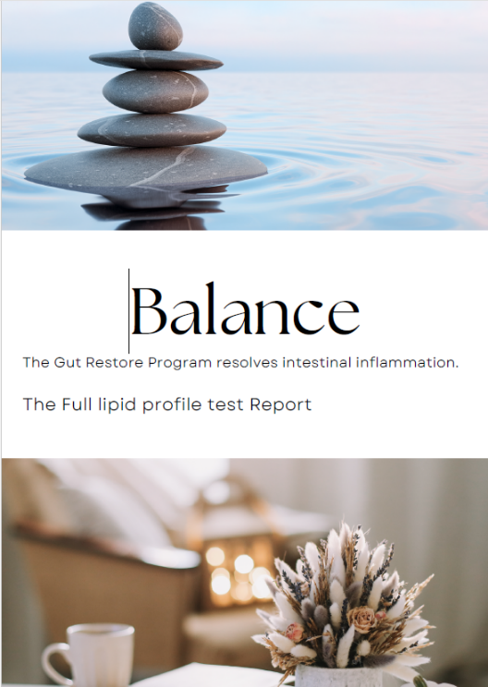
Balance is the answer
Thank you
Lifestyle Interventions
to resolve intestinal inflammation
Omega-3 and microbial balance
restore@investinyour.health

