Slide 1
Nonspecific chronic back pain and scoliosis of the spine.
Clinical Observations
Anselm Model
DM, Specialist in PRM, Hospital «Fachkliniken Sonnenhof,» Department Orthopaedics, Hoechenschwand/Germany
(anselm.model@t-online.de)

Slide 2
Introduction
Nonspecific chronic back pain is a widespread medical and social problem and is thought of being one of the most frequent causes for loss of workplaces and for long unemployment. But may the diagnosis “nonspecific chronic back pain” be transformed into “specific back pain” by more extensive diagnostic assessments? Might so patients be treated more specifically by adapted exercises and manual therapies?
In our rehabilitation hospital, we have seen a lot of patients with chronic back pain in the last decades. Most of them have been worker, females and males of different ages, but also many soldiers and persons of other professions. Because there had not been found any specific cause for their pains in the preceding physical examinations , they have been told by their doctors they suffer from nonspecific chronic back pain. But, having listened to their pain history and having made a thorough and more extended physical examination of them, we have doubted that there would be no specific cause for their pain. Further, we did not think that their pain might be caused by underlying psychological and social factors, primarily.

Slide 3
Material and Method
Over ten years, we have carefully analysed all our patients (about 1800) who entered our hospital with the diagnosis “nonspecific chronic back pain” in deviations of their total spine. Thus, for instants we have not only proofed the crest of their pelvis and its position in standing as usual, but also in sitting position.
In addition, all patients have been explored in aspects of manual therapy and if needed they have been treated manually.

Slide 4
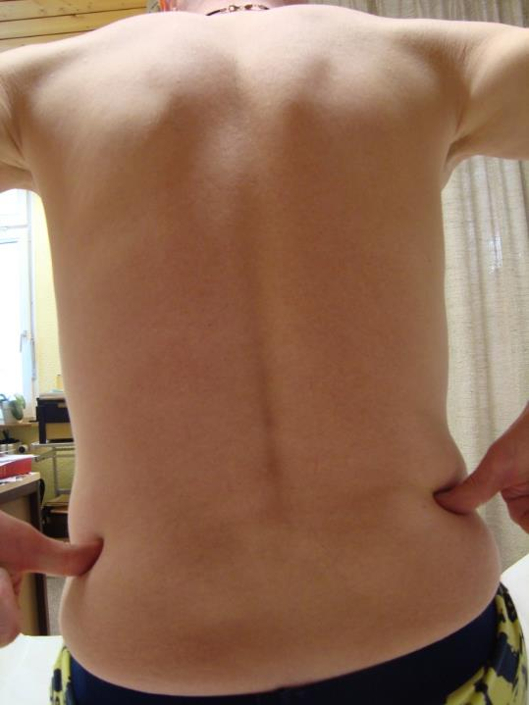
Hints for Detecting a slight scoliosis in the physical examination of a patient
In standing, a mild scoliosis might easily be missed to be noticed in the physical examination of a patient, but when checking the iliac crest of the patient’s pelvis in sitting there will be always seen a significant difference of the heights between the right and the left side of his pelvis. The right side (as here in the picture) will stand significantly higher as the left, in most cases.
Notice that different lengths of the patient’s legs may change the position of his pelvis in standing but cannot influence the position of his pelvis in sitting.
Therefore, on should always check a patient not only in standing as usual, but also in sitting.

Slide 5
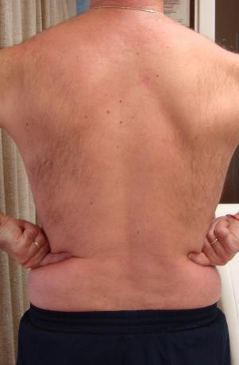
Results
All our patients had a scoliosis of their spine mostly discreet beneath 25 degrees (Cobb). They had further always a segmental somatic dysfunction in the middle of their thoracic cage (besides variable further dysfunctions).
Pain relief, total or to a large extend, has been noted in treating these somatic dysfunctions successfully.
segmental somatic dysfunction in different regions
mild scoliosis oft their spine

Slide 6
Conclusions
A scoliosis of the spine, mostly a mild one, which facilitates recurring aching somatic dysfunctions, seems to be connected to a large part of nonspecific chronic back pain.
Treating these recurring segmental dysfunctions with specific exercises (that patients may learn doing by themselves) or manually by a therapist may be the most convenient way in managing this widespread social and medical problem successfully.

Slide 7
Managing her aching somatic dysfunctions by the patient herself
There will be different successful ways to treat somatic dysfunctions as by the patients themselves as by their therapeutics.
Our patients have been told the following simple exercises, developed by myself, which the patients may practise even at their workplace within a minute.

