Slide 1
Health Outcomes of Lifestyle Behaviour Interventions:: Multicomponent Technology-Assisted and Lifestyle-Based Physical Activity
with Balanced Nutrition ON
Older Adults
HEPA Macedonia National organisation for the promotion of
Health-Enhancing Physical Activity, WHO HEPA EUROPE
Univ. MIT Skopje, Food Quality and Safety
University Professor Vera SIMOVSKA, MD., PhD
Andrej Simovski, Eng. Of Nutrition, MSc.

Slide 2
ABSTRACT
I. INTRODUCTION: Ageing is a continuous process of growth and change. Advanced age places a person in a separate category from the rest of society. Promoting healthy lifestyle behaviours is a great way to help adults at an advanced age to prevent and manage health problems.
The process of ageing affects health, nutritional status, and health-related components of physical fitness: cardiorespiratory capacity, muscle strength, balance and flexibility. Cardiorespiratory fitness is one of the most studied physical fitness components. Older adults lose half of their initial aerobic capacity reaching 50% at 70 years of age.
Older adults reduces their adherence to lifestyle changes, facing multiple barriers, especially to physical activity interventions. Motivation-related barriers, chronic health conditions, physical or cognitive limitations, pain, and opportunity-related barriers are emphasized from users' experience.
Social connection and communication are crucial components of person-centred care for older adults, especially those who may live alone.

Slide 3
II. THE AIMS
The aims of the study are to assess the health-related components of physical fitness and other health outcomes of persons at
an advanced age, participating in lifestyle behaviour interventions:
1. Multicomponent, digital technology-assisted physical activity incorporating endurance, muscle strengthening, balance and flexibility training in addition to healthy nutrition behaviour.
2. Lifestyle-based physical activity in the home environment including initial instruction, with periodic supervision, and equipment for exercises. It is focused on self-management of one's own physical activity behaviour changes that fit best with lifestyle.

Slide 4
III. RESULTS:
What is the significant contribution to health-related fitness components and functional outcomes influenced by lifestyle behaviour intervention?
Cardiorespiratory fitness, muscle strength and balance are the key health outcomes with high response to multicomponent, digital technology – assisted physical activity in addition to the benefit of reducing the risks of chronic diseases in older adults. Digital technologies may increase physical activity levels and long-term adherence.
Regarding dietary behaviour, sedentary older adults are at risk of protein deficiency if their protein intake is limited.
IV. CONCLUSION:
These facts will serve as the basis for developing novel approaches, strategies and guidelines. New strategies to promote physical activity among older adults in key settings, including a home-based environment will be implemented during 2023.

Slide 5
A sedentary lifestyle in old age is associated with an increased risk of chronic diseases (NCDs), mortality, and economic burden for society.
To reduce the risk of NCDs associated with physical inactivity there is a need to improve knowledge and practice-based interventions.
The main aim of the COST Action “PhysAgeNet” is to establish a sustainable network that will foster evidence-based research and practice of physical activity in older adults.
We have integrated innovative ICT solutions based on open data consolidated research information.

Slide 6
There are needs and gaps in research and practice about the successful implementation of evidence-based medicine (EBM) for the training of older adults:
Exclusion of disabled, low-income and isolated older adults;
Lack of real-world data (RWD) collected of the studies over long periods;
Limited use of technological innovations for assessing, applying and Health - Enhancing Physical Activity and exercise programs in older populations.
There is an urgent need for creating "tailored" exercise programmes that will fit the specific needs of the various and diverse ageing populations.

Slide 7
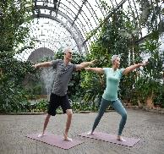
Health Benefits
- Older adults can benefit from regular physical activity to maintain aerobic and physical fitness components: muscular strength to maintain independence, increased bone density which may lead to a reduced risk for osteoporosis, and increased balance and flexibility, which prevents falls and decreases the risk of injury and disabilities with increased mobility and gait.
- Improvements in mental health include memory and cognitive function, improved quality of life, decreased depression, increased well-being, decreased stress, and improved sleep.
- Prevention of the main NCDs through key risk factors, enhanced immune function, increased energy expenditure, and improved body composition.
- Participation in appropriate, technology-assisted and enjoyable physical activity can be a way to maintain social contact and reduce feelings of isolation and loneliness increasing the ability to perform daily activities.

Slide 8
Methods of PhysAgeNet
The scoping review was conducted according to the
Joanna Briggs Institute (JBI) methodology for scoping
reviews (Peters et al., 2020) classifying the search terms.
All identified citations were collated and uploaded into Rayyan.
The results of the search and the study inclusion process were
reported in full and presented according to the PRISMA-ScR flow
diagram (Tricco et al., 2018).
The database search was performed on October 2022.
Data summarising and analysis were done from published
203 eligible studies. Studies were excluded if the intervention’s
main purpose is the treatment or rehabilitation of a specific
disease-related deficit within a clinical setting.

Slide 9
Facts About Digital Health Technology
The digital health technologies used to deliver the physical activity intervention was selected in accordance with the WHO classification of digital health interventions (DHIs) and the NICE Evidence Standards Framework for digital health and care technologies with or without measurable patient outcomes and which provide services to the health care system.
Characteristics of technology:
Design, and types of interaction with participants:
Function – Interface – Usability.

Slide 10
Outcomes focused on digital health (welfare) technology
Key findings:
User experience (based on participant’s experience)
Safety
Dropout and adherence
Factors related with participant interaction: impact on participants experience of the intervention
Factors related to use of technology (what participants noticed using the technology)
Barrier/facilitators related to health outcomes

Slide 11
Health-Enhancing Physical Activity - Health Promotion and NCDs Prevention

Slide 12
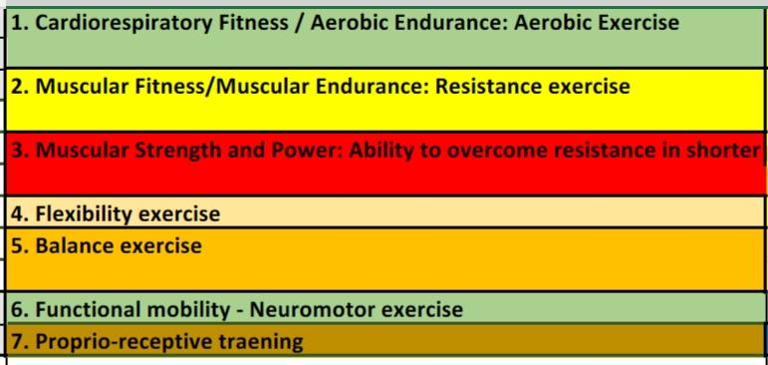
Cardiorespiratory fitness/
aerobic endurance – Aerobic exercises
Health-related components of physical fitness

Slide 13
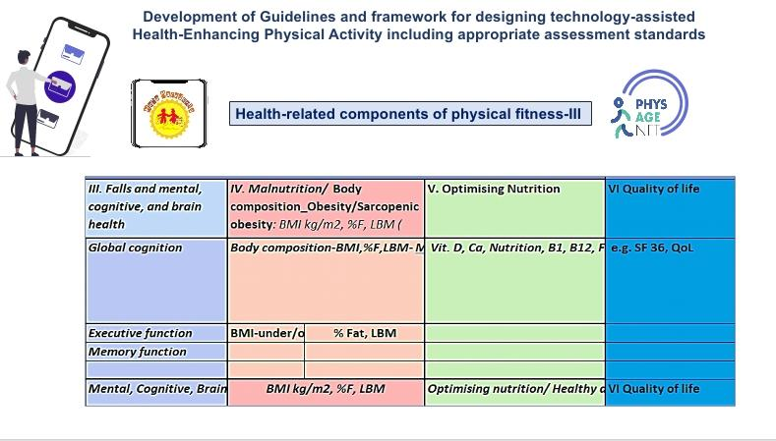
Development of Guidelines and framework for designing technology-assisted
Health-Enhancing Physical Activity including appropriate assessment standards
Health-related components of physical fitness-III

Slide 14
Process and consequences related to sarcopenia and ageing
Protein enriched and balanced diet with carbohydrate supplementation and light intensity resistant training enhances LBM and muscle strength, eliminate a risk of falls and fraility. Essential amino acids supplementation in the interaction with resistant and balance exercise will improve the muscle protein synthesis in ageing.

Slide 15
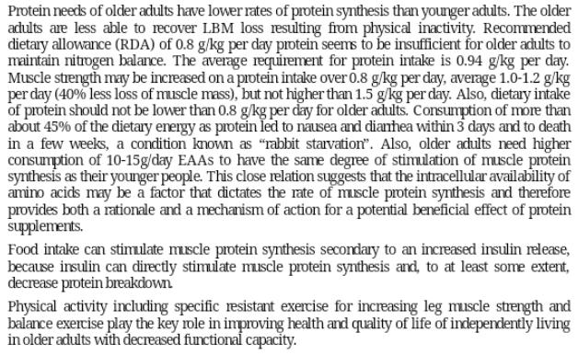
Anabolic Resistance in Ageing

Slide 16
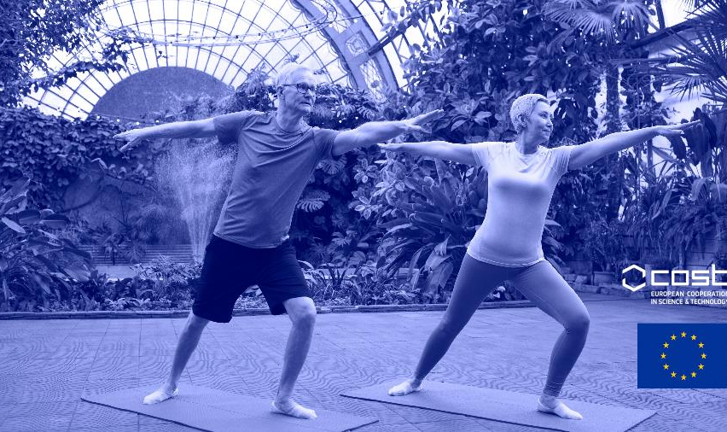
Presentation Template
Follow me:
COST Action CA20104
NETWORK ON EVIDENCE-BASED PHYSICAL ACTIVITY IN OLD AGE
(PhysAgeNet supported by COST Action)
Notes:
lifestyle

Slide 17
Contact Info
Phone
+ 389 2 60 90 775
+ 389 78 226 009
Email
vera.simovska@uklo.edu.mk
Email: hepa@hepa.org.mk
https://www.hepa.org.mk

Slide 18
Thank You

