Slide 1
Physical Activity from the Point of View of Subjective Well-Being and Support of Healthy Behavior
Klaudia Zusková
Pavol Jozef Šafárik University in Košice
Institute of Physical Education and Sport
Slovakia

Slide 2
HEDONISM
ancient philosophical direction, the motive of behavior is pleasure
H
EUDAIMONIA
a philosophical-ethical concept for which happiness is the highest value and purpose of humanity
E

Slide 3
SUBJECTIVE WLL-BEING CONCEPT by E. Diener at al. “Dr. Happiness”
One evaluates one's own life emotionally and cognitively
Frequent pleasant feelings, infrequent unpleasant feelings, and an overall judgment that life is satisfactory
Flourishing (personal growth)
Scales: SWLS, SPANE, FS
H H E
https://eddiener.com/
Diener et al.(2018)

Slide 4
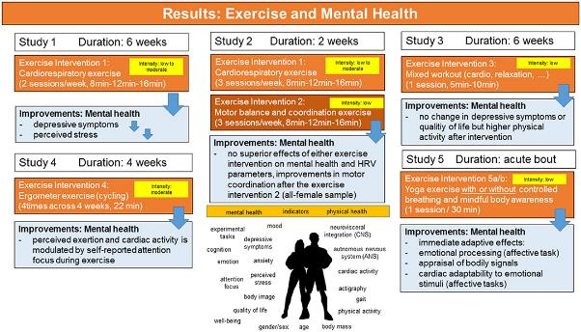
Physical Activity (PA) and Sport – Mediating Factors - 5 thoughts
PA is associated with higher levels of subjective well-being (Iwon et al., 2021)
Sport can increase subjective well-being, but also decrease it (Giles et al. 2020).
Herbert (2022)
By the age of 80, the amount of additional life attributable to adequate exercise, as compared with sedentariness, was one to two years (Paffenbarger, 1986).
Changes in health behavior and subjective well-being have long-term efects on each othert, the efect of the frst being slightly stronger than vice versa (Stenlund et al., 2022).

Slide 5
The Impact of Sport on Mental and
Social Prosperity
+ The impact of sport on mental development:
self-esteem, motivation and resilience (Weinberg, 2019).
+ The impact of sport on social prosperity:
communication, development of relationships and cooperation, fostering a sense of belonging (Beauchamp and Eys, 2014).
- The impact of sport on mental development:
Psychological well-being can be adversely affected by poor performance, injuries, pressure and expectations, burnout and the development of maladaptive psychological symptoms and disorders (Rice SM, 2016).
- The impact of sport on social prosperity:
Social well-being - threatened by unsupportive environment, excessive control, discrimination, harassment, bullying, stalking, abuse, group conflict and isolation (Crow, 2009).
Focus Groups, Zusková et al. (2022)
Goal: qualitatively identify the specifics of SWB experienced by 27 female and male athletes in their environment.
Grant research: No. vvgs-2021-1857

Slide 6
H
attractive exercise (content)
attractive physical environment
joy - social entertainment
the experience of success
flow
short term goals
etc.
long term goal
challenge
meaningfulness
self-realization
benefit
etc.
E
ATTITUDE COMPONENTS:
Affective
Cognitive
Behavioral/
Connative

Slide 7
Thank you and see you in beautful central Europe in Slovakia and Czechia :)

