Slide 1
Integrating Lifestyle Medicine
Into Routine Endocrinology ​Care of Women​ Anna Giulia Palladino-Davis ​
5th European Lifestyle Medicine Congress
Friday 10th of November 2023 | Budapest, Hungary

Slide 2
Disclosure
I have no financial disclosure or conflict of interest in relation to this presentation

Slide 3
Learning Objectives
Extrapolate areas of lifestyle medicine into individual scope of practice
Distinguish and integrate lifestyle medicine concepts from existing hospital system resources

Slide 4
What is Lifestyle Medicine?
Lifestyle Medicine
Evidence-based medical specialty rooted in primary modalities to prevent, treat, and possibly reverse non-communicable, chronic diseases.
Six Pillars
Health Equity
Whole-person Health
Lifestyle Medicine has applicability to individual and population health
Specific to Northwestern Medicine, elevate existing services across the health system, specific to the North Region

Slide 5
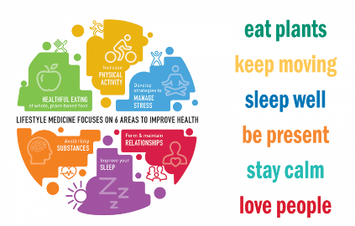
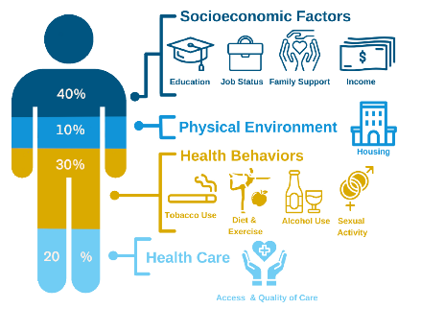
Perception vs. Reality

Slide 6
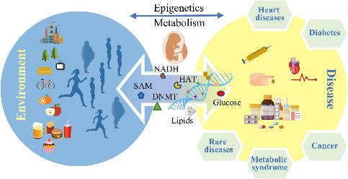
Importance of Lifestyle Medicine
Lessons from COVID-19
Healthcare spending
Epigenetic alterations
Health disparities
Innovations to standard of care

Slide 7
Integrating Lifestyle Medicine in Cardiometabolic Specialties
Management continuum
Inherent need for increased healthcare
Impactful period in life

Slide 8
Integrating Lifestyle Medicine into Endocrine Care
Gestational Obesity, Obesity, PCOS, Pre-Diabetess, GD, T1D, T2D
Identify preventive care gaps in current women’s care in the endocrine clinic
Operationalize Lifestyle Medicine services, TTC, pregnancy, and postpartum
Centralize linkages of services
Provide enhanced disease management & prevention
Disease reversibility potential

Slide 9
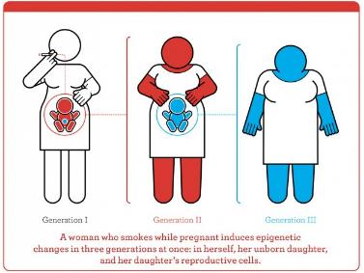
Integrating Lifestyle Medicine into Endocrine Care
#GOALS
Lifestyle Medicine can have short and long-term implications in women with gestational obesity
Reduce the risk of Gestational Diabetes
Reduce the risk of pre-eclampsia
Reduce the likelihood of macrosomia
Reduce the risk of childhood obesity in offspring

Slide 10
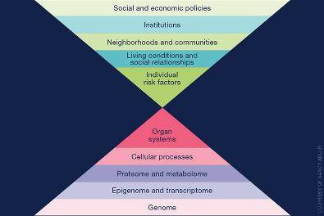
Quality Improvement Program at a Glance
Cognitive and Affective Attitudes
Endocrine Clinic
Gestational obesity (BMI >30) at the time of the first prenatal visit
Lifestyle Medicine questionnaires to assess the lifestyle vital signs of participants and refer as appropriate
Precision public health
“The right intervention at the right time, every time to the right population” CDC

Slide 11
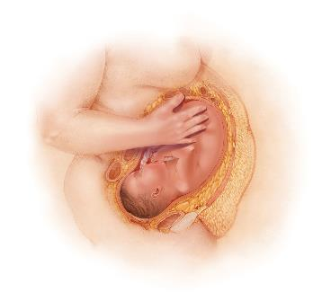
Program at a Glance
Lifestyle Medicine questionnaires
Nutrition
Sleep
Physical Activity
Relationships & Stress Management
Risky Substances

Slide 12
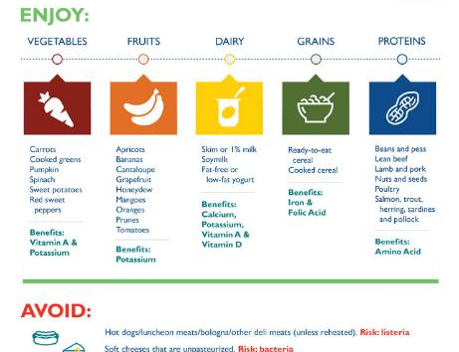
Lifestyle Medicine in Endocrine Care: Nutrition
Registered Dietician
Instagram
App
Group based sessions
Culturally sensitive
Culinary Medicine
Behavioural change therapy

Slide 13
Lifestyle Medicine in Endocrine Care: Exercise
Sports Medicine
Physical Therapy
Personal Trainer
My FitRx
Group classes
Trimester appropriate

Slide 14
Lifestyle Medicine in Endocrine Care: Sleep
Sleep Medicine Specialists
Mental Health Professionals
Mindfulness

Slide 15
Lifestyle Medicine: Stress Management
Mental Health Professionals
Medical-Legal Clinics
Tangible Solutions
Linkages of services
Social determinants of health

Slide 16
Lifestyle Medicine: Relationships
Social Support
Family & Friends
Groups & Networks
Spiritual Support
Prayer
Presence
Community

Slide 17
Lifestyle Medicine: Risky Substances

Slide 18
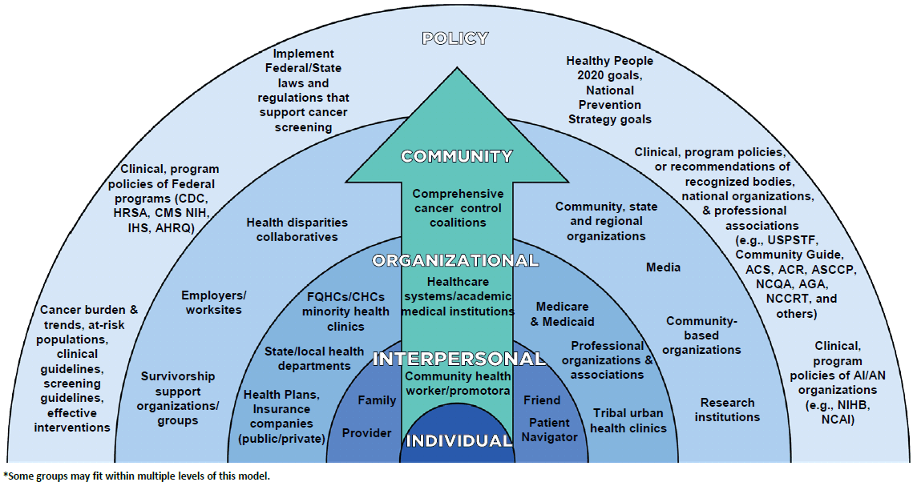
Social-Ecological Model
Encompass the world of participants
Individual/Intrapersonal
Self-efficacy
Goal setting skills
Sustaining progress long-term
Interpersonal
Institutional/Organizational
Social structure, policy, and systems

Slide 19
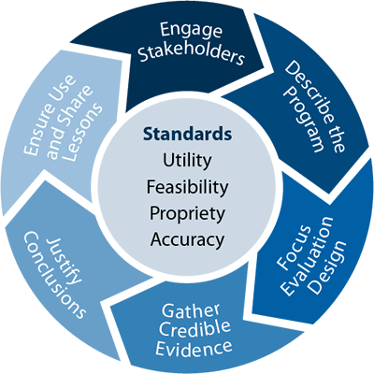
Evaluation Plan
Formative Evaluation
Outcome Evaluation
Process Evaluation

Slide 20
Returning Medicine and Individuals to Homeostasis

Slide 21
Acknowledgements
Anthony J. Pick, MD
Matthew J. O’Brien, MD
Ronald T. Ackermann, MD, MPH

Slide 22
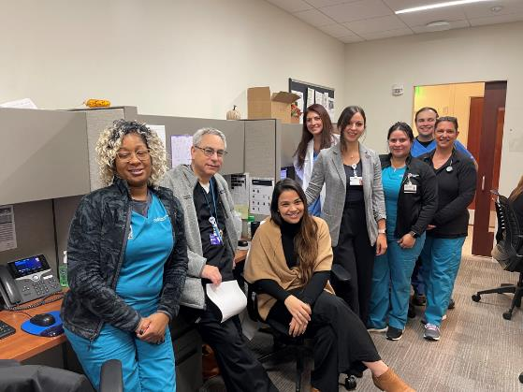
Endocrine Team: North Region

Slide 23
Questions? Ideas? Concerns? Objective Criticism… APD21@Northwestern.edu

Slide 24
Gracias ​ Grazie​ Thank You​ Köszönöm​

