Slide 1
ORAL FUNCTION
&
LIFESTYLE MEDICINE
THE CURRENT EVIDENCES
ANDREIA PATRÃO - BUDAPEST - 12 NOVEMBER 2023 - OP18

Slide 2
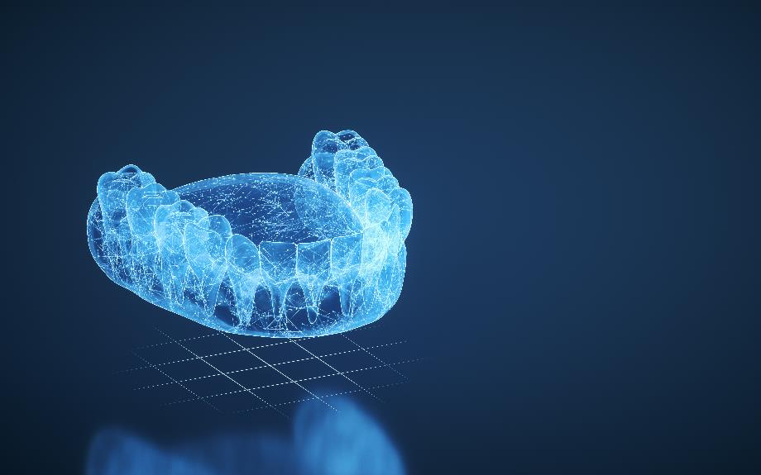
FROM HEALTH TO LONGEVITY
why does
ORAL
HEALTH
ORAL
HEALTH
matter?

Slide 3
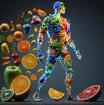
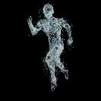
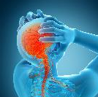
METHODS
1
A bibliographic search was conducted in the Pubmed, Medline, and Google Scholar databases in two phases: first, a comprehensive literature review was performed, focusing on the link between oral health and overall health.
Then, an independent research was conducted concerning oral health and its association with the six pillars of Lifestyle Medicine: Nutrition, Exercise, Sleep, Stress, Substances Exposure, and Social Relations.
The sample included articles published between 2000-2023, resulting from qualitative primary research and theoretical studies, and 77 scientific articles and 2 books related to the topics were selected for the final sample, supporting this oral presentation.
ORAL HEALTH
2
OVERALL HEALTH
LIFESTYLE MEDICINE
3

Slide 4
ORAL HEALTH
The Stomatognatic System performs vital functions essential for human survival:
State of the mouth, teeth and orofacial structures that enables individuals to perform essential functions, such as eating, breathing and speaking, and encompasses psychosocial dimensions, such as self-confidence, well- being and the ability to socialize and work without pain, discomfort and embarrassment. Oral health varies over the life course from early life to old age, is integral to general health and supports individuals in participating in society and achieving their potential.
World Health Org 2022
MASTICATION, SWALLOWING AND TASTE
BREATHING
SPEAKING
SMILE
AESTHETIC
APPEARENCE
SMOKING & ALCOHOL
POSTURE
AND BALANCE
ORAL FUNCTION

Slide 5
ORAL DISEASES
5 TYPES OF CANCER & 28 NCDs
Non-Communicable Disease
CARDIOVASCULAR DISEASE
AFFECTING ALMOST HALF OF THE WORLD’S POPULATION
TYPE 2 DYABETES
DENTAL CARIE
NEURODEGENERATIVE CONDITIONS
PERIODONTAL DISEASE
DEPRESSION
THE 4 MAJOR ORAL DISEASES OVER THE LIFE COURSE
14 NCDs were associated with a higher risk of having an oral disease
ASTHMA
The exposure of an oral disease increasing the risk towards a NCDs
ORAL CANCER
RHEUMATIC DISEASES
EDENTULISM
OBESITY
BRUXISM
INFLAMMATORY BOWEL DISEASE
(WHO, 2022)
…
May impact systemic health through multiple pathways… there is a close often bidirectional association between oral diseases and systemic diseases, particularly with other NCDs.
SYSTEMIC DISEASES
Botelho et al. An umbrella review of the evidence linking oral health and systemic noncommunicable diseases. Nat Commun. 2022 Dec 9;13(1):7614.

Slide 6
ORAL FUNCTION
LIFESTYLE MEDICINE
NUTRITION
EXERCISE
STRESS
SLEEP
SUBSTANCE
EXPOSURE
SOCIAL
RELATIONS

Slide 7
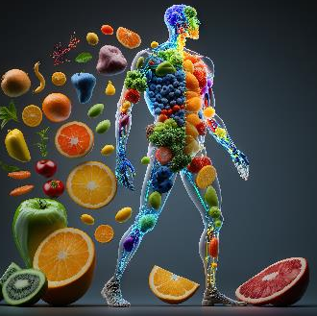
ORAL FUNCTION & NUTRITION
MASTICATORY PERFORMANCE
is a key modulator of health
AFFECTED BY THE NUMBER OF TEETH IN FUNCTIONAL OCCLUSION
TOOTH LOSS
OVERALL HEALTH
Periodontal Surgery Outcomes
CHEWING DIFFICULTIES
PERIODONTAL DISEASE
CHRONIC DISEASES
affects dietary patterns and determines food selection
DENTAL CARIES
>20
TEETH
MINERALIZATION PROCESS
decreased protein and micronutrient intake, together with increased CH consumption in people with less than 21 teeth.
selection soft and easy-to-chew foods and leading to suboptimal nutritional status
INADEQUATE
NUTRITION

Slide 8
ORAL FUNCTION & EXERCISE
OCCLUSION
PERIODONTAL DISEASE
(local inflammatory condition)
OVERALL HEALTH
BALANCE PERCEPTION
PHYSICALLY FIT INDIVIDUALS HAVE A GOOD PERIODONTAL STATUS
MOTOR FUNCTION
Significantly
Lower Risk
moderate p.a. at least 5 times a week
vigorous p.a. at least 3 times a week
POSITIVE EFFECTS in OCCLUSION INTERVENTIONS
Posture and Postural Control
Balance Function
Walkig and Running Biomechanics
Endurance Strenght Performance
Physical Activity reduce inflammatory biomarkers
(CRP, 1L-1b..)
Supress inflammatory response
HIGH PERFORMANCE
!!
PROTECTIVE SPLINTS
SPORT BEVERAGE AND SNACKS (SUGARS)
BREATHING
SARCOPENIA
(Lost of muscle mass and function)
Whole Body Process
BREATHING, MASTICATION AND SWALLOWING MUSCLES
Lifestyle Habits: malnutrition and physical inactivity

Slide 9
ORAL FUNCTION & STRESS
Predisposing factor
Biological, Psychosocial and Lifestyle Risk Factors
STIMULATE OF INFLAMMATORY PROCESS
genetic; imbalance in centrally acting neurotransmitters (serotonin, dopamine)
anxiety, depression, stress, smoking, alcohol.
CORTISOL LEVELS
IL-1B
Systemic Inflammatory Burden
BRUXISM
behaviour of masticatory muscle activity
PERIODONTAL DISEASE
Chronic Inflammatory Disease
RISK FACTOR
OVERALL HEALTH
&
WELL-BEING
ORAL CONSEQUENCES
Excessive occlusal forces
Tooth Wear
Tooth fracture / chippage
Temporomandibular disorders
Periodontal Disease
GENERAL CONSEQUENCES
Chronic migraine
Oro-Facial and Cervical muscle pain
Headache upon awakening
Awakening Sleeping
Multidisciplinar Approach
TREATMENT: Counselling, Oclusal Appliances, Physiotherapy, Psychotherapy and Pharmacotherapy
Mainly regulated centrally
Diagnosis: PSG + EMG

Slide 10
ORAL FUNCTION & SLEEP
SB prevalence in adults with OSA
33%-54%
PSG diagnosis
SLEEP BRUXISM
OBSTRUCTIVE SLEEP APNEA
TREATMENT
Continuous Positive Airway Pressure
Oral Appliances
90% of episodes
involve grinding teeth
high risk factor to morbidity and mortality from all causes
Lobbezoo et al 2018
sleep arousal
difficulty maintaining sleep
SLEEP
& WELL-BEING
OVERALL HEALTH
& WELL-BEING
Clinical Consequences

Slide 11
ORAL FUNCTION & SUBSTANCE EXPOSURE
ALCOHOL
SMOKING
Smokers have a higher risk of tooth loss when compared to non-smokers
Oral Cancer
Bruxism
Periodontal D.
Aesthetic
Heavy smokers have at a 3-fold greater risk of developing oral cancer than non-smokers
Shimazaki, 2015
Predisposing Factor
Important independent risk factor for periodontal disease.
Exacerbates periodontal disease and affects treatment prognoses.
4-5- fold greater risk vs non-smokers
Teeth Discoloration

Slide 12
ORAL FUNCTION & SOCIAL RELATIONS
OTHERS
SELF
Speak
Smile
Express Emotions
Eating
Aesthetic
Self-esteem and Confidence
COMMUNICATION
MASTICATION
AESTHETIC APPEARANCE
All scenarios in which tooth loss occurred resulted in reduced social participation.
Cooray et al 2023; Qi et al 2023
Social isolation can lead to poor dietary habits, less frequent toothbrushing, less frequent dental visits that conducted a poor oral health
Takahashi et al 2023

Slide 13
LIFESTYLE MEDICINE
SOCIAL
RELATIONS
SLEEP
STRESS
PHYSICAL
ACTIVITY
NUTRITION
SUBSTANCES
EXPOSURE
OVERALL HEALTH
SMILE
Chronic Systemic Inflammation
ORAL
HEALTH
DENTAL CARIES
BRUXISM /OCLUSION
PERIODONTAL DISEASE
ORAL CANCER
EDENTULISM

Slide 14
SCIENCE
LOADING…
WHAT WE KNOW NOW ?

Slide 15
WHAT WE KNOW NOW…
ORAL DISEASES ARE A GLOBAL PUBLIC HEALTH PROBLEM
PREVENTION AND ACCESS TO BASIC ORAL HEALTH IS NOT EQUALLY
ORAL DISEASES ARE THE MOST WIDESPREAD NONCOMMUNICABLE DISEASES AFFECTING ALMOST HALF OF THE WORLD’S POPULATION (45%) OVER THE LIFE COURSE FROM EARLY LIFE TO OLD AGE (WHO, 2022)
SHARED RISK FACTORS FOR NCDs AND ORAL DISEASES
SMOKING, STRESS, EATING HABITS, LACK OF EXERCISE.
DISEASES CLOSE RELATION: ORAL + SYSTEMIC = MULTIDISCIPLINARY APPROACH
(CVD, T2 DIABETES, OBESITY, …)

Slide 16
WHAT WE KNOW NOW…
PREVENT AND TREAT PERIODONTAL DISEASE IS PREVENT ALSO CHRONIC SYSTEMIC INFLAMMATIONS LEVELS
THE POTENTIAL BENEFITS OF DENTURE USE IN MITIGATING THE ADVERSE EFFECTS OF TOOTH LOSS
PREVENT TOOTH LOSS AND ENCOURAGE PEOPLE TO REMAINING AT LEAST 20 TEETH AT 80 AGE
ENCOURAGE PATIENTS TO VISIT DENTIST REGULARLY (1 a 2 x/ year)

Slide 17
FROM HEALTH TO LONGEVITY
ORAL HEALTH
ORAL HEALTH
matter!
Thank You!
ANDREIA PATRÃO
Dentist, Oral Rehabilitation
and Lifestyle Medicine
Porto, Portugal
QUESTIONS?

