Slide 1




The HYGIEIA Project: Co-creation of a European Joint Master Degree on health and wellbeing promotion
Catarina Rosado, Ana Sofia Fernandes
CBIOS, Universidade Lusófona’s Research Center for Biosciences & Health Technologies, Lisboa, Portugal

Slide 2

HYGIEIA
Goddess of health, cleanliness and sanitation, adored by her power to prevent –not cure– sickness

Slide 3

RISK PREVENTION STRATEGIES
LIFESTYLE EDUCATION
NUTRIONAL EDUCATION
NON-DRUG PRODUCTS
SUSTAINABILITY
GREEN DEAL
Audacious transnational educational project
Addressing a demanding societal challenge
Integrated knowledge in the health and wellbeing market
Based on the principle of interdisciplinarity
FOOD SUPPLEMENTS
COSMETICS
DIGITAL TOOLS

Slide 4



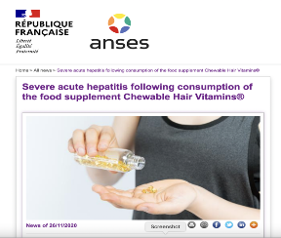


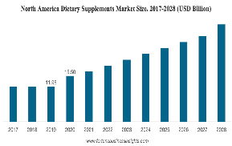

Needs analysis
HYGIEIA will bring evidence-based knowledge to the health and wellbeing industry
HYGIEIA operates in an area of high economic impact and strategic relevance
HYGIEIA will help to establish Europe as a global beacon in the health sciences formative offer
Daily Mail: Nutritionist reveals 16 of the most outrageous health claims spread on social media in 2019

Slide 5









HYGIEA Erasmus Mundus Joint Masters
Universidade Lusófona
  kick-off and introduction
Universitat de les Illes Balears
  Nutrition and healthy lifestyle
Belgrade University
  Non-drug products
Project/ Dissertation
2 academic years / 120 ECTS credits

Slide 6
HYGIEIA co-creation plan
Online Surveys
Focus Groups
Brainstorming
Design of syllabus / contents
Definition of complementary training activities
Establishment of the promotion strategy
Consortium Enlargement

Slide 7
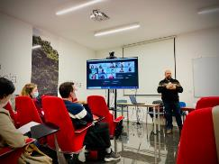
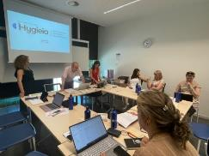
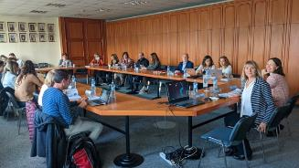
Focus Groups
Priorities in Health and Wellbeing training
Lisbon, Mallorca, Belgrade
Employers (Cosmetics and Food Supplements Industry)
Students
Academia ( Health Sciences, Sports Sciences, Psychology)
    Europe and Latin America
Health professionals and Medical Societies
Health and regulatory authorities
Health needs of aging population
Burden of chronic diseases in modern societies
Environmental and social determinants of health and well-being
Sustainable strategies in health promotion and wellness
Personalized non-drug products
Role of health systems in health promotion
Communication
Health literacy

Slide 8



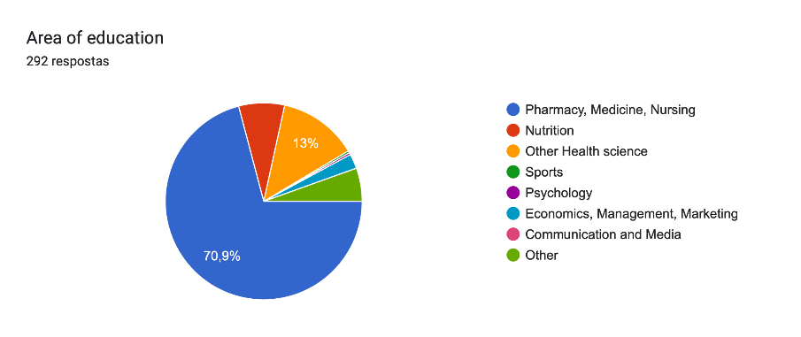

On-line Surveys
292 Potential students
Mainly 19-23 Years old

Slide 9
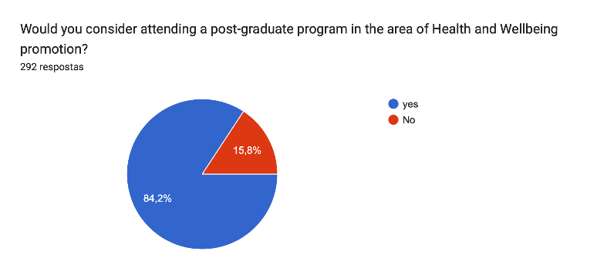
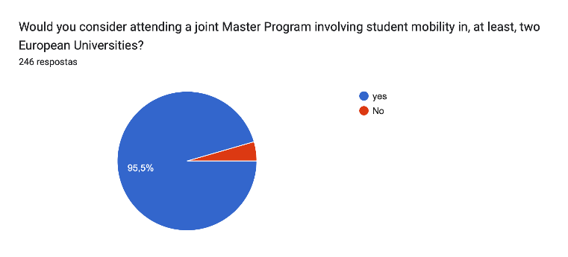
Surveys
292 participants
246 participants
Mostly due to financial reasons

Slide 10
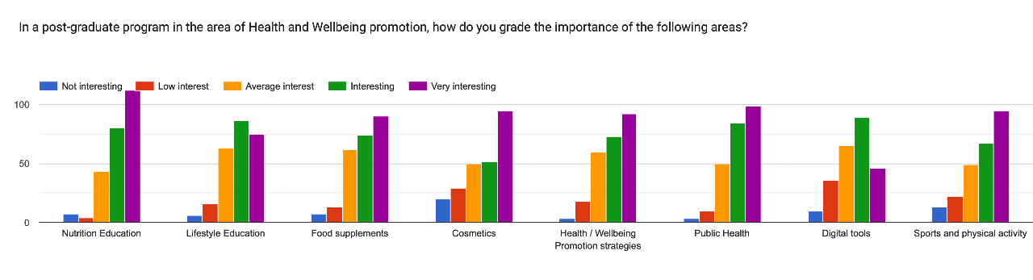
Surveys
292 participants

Slide 11
The consortium under construction
Associated Higher Education Partners
  Universidade de S. Paulo, Brazil
  Universidad Autonoma de Nueva León, Mexico
  Srinakharinwirot University, Faculty of Pharmacy, Thailand
Associated Partners - Industry
  DietMed, Europe, Asia, Africa
  Crystal Derma Doo, Serbia
Associated Partners- other stakeholders
  Global Cosmetics Cluster, Europe
  IMI- Institute for Medical Research and Occupational Health, Croatia
Healthcare Providers
  Luz Learning Health (GLSMED Learning Health SA), Portugal
  Drª Cecilia Castillo Lancellotti Paediatrics Clinics, Chile
Medical Societies
  European Lifestyle Medicine Organization
  Portuguese Society for Health Literacy, Portugal

Slide 12

Enlarging the collaborative web
Participating in the consortium
  Teaching activities
  Integrated complementary teaching/ training activities
  Internship placement
  Dissemination and communication activities

Slide 13
You are all welcome in HYGIEIA activities!
Developing the concept
Building the Consortium
Gathering Information
Co-creation of a EMJM
Submission of proposal at EMJM call February 2024

Slide 14


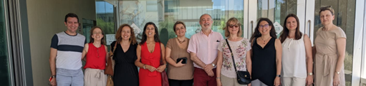




ACKNOWLEDGEMENTS
catarina.rosado@ulusofona.pt
ana.fernandes@ulusofona.pt
https://hygieia.ulusofona.pt/
This project has received funding from the Erasmus2027 programme under grant agreement No 101049786.

