Slide 1
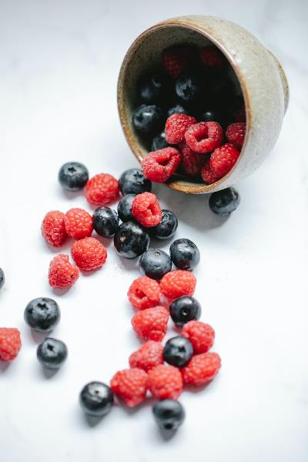
Investigation of pseudocereal-based beverages enriched with antioxidants, protein and fibre
Lecturer:
Dorottya Krisztina Vajdovich
PhD-student, Dietitian BSc, Nutritionist MSc in Nutritional Sciences, Semmelweis University, Faculty of Health Sciences, Department of Dietetics and Nutritional Sciences
Notes:
Dear Audience! I warmly welcome everyone to the 5th ELMO-congress!
I’m Dorottya Vajdovich, I’m a PhD-students in nutritional sciences
In my research, I examined antioxidant-, protein- and fibre-enriched pseudocereal-based plant drinks

Slide 2
Literature backround
WHO. (2018). Ageing and health. Retrieved from https://www.who.int/en/news-room/fact-sheets/detail/ageing-and-health
Nagy, B., Nagy-Lőrincz, Z., Bakacs, M., Illés, É., Sarkadi Nagy, E., & Martos, É. (2017). Országos Táplálkozás és Tápláltsági Állapot Vizsgálat – OTÁP2014 III. A magyar lakosság makroelem-bevitele. Orvosi Hetilap, 158(17), 658-660.
Pálfi, E. (2016). Új táplálkozási stratégia az egészséges öregedés érdekében - a NU-AGE projekt eredményei. Új Diéta, 2016(5), 2-5.
Giampieri, E., Ostan, R., Guidarelli, G., Salvioli, S., Berendsen, A. A. M., Brzozowska, A., . . . Santoro, A. (2019). A Novel Approach to Improve the Estimation of a Diet Adherence Considering Seasonality and Short Term Variability - The NU-AGE Mediterranean Diet Experience. Front Physiol, 10, 149. doi: 10.3389/fphys.2019.00149
Notes:
What did the choice of my topic justify?
World Health Organisation predicts 38% increase in the number of people over 65 by 2025. However, longer life expectancy is not directly proportional to healthier life because sarcopenia is an increased risk factor in old age.
The data of the National Nutrition Survey in the recent years showed that the fibre intake of the population is insufficient, it is well below the recommended daily intake of 25 g. The protein intake of the Hungarian population is adequate but predominantly comes from foods of animal origin.
The main aim of the European Union's NU-Age project was to develop a nutritional recommendation that slows down aging and keeps the healthy condition for as long as possible, with the primary solution being to increase the consumption of protein, fiber and water.

Slide 3
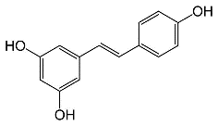
Importance of antioxidants
Too many free radicals → oxidative stress
Antioxidants neutralize excess of free radicals
"Antioxidants are compounds that (…) protect us against the toxic effects of reactive intermediates "
Arts, M. J. T. J., Haenen, G. R. M. M., Wilms, L. C., Beetstra, S. A. J. N., Heijnen, C. G. M., Voss, H. P., & Bast, A. (2002). Interactions between Flavonoids and Proteins: Effect on the Total Antioxidant Capacity. Journal of Agricultural and food chemistry, 50, 1184-1185.
Arulselvan, P., Fard, M. T., Tan, W. S., Gothai, S., Fakurazi, S., Norhaizan, M. E., & Kumar, S. S. (2016). Role of Antioxidants and Natural Products in Inflammation. Hindawi, 2016, 4-10.
Khan, N., & Mukhtar, H. (2018). Tea Polyphenols in Promotion of Human Health. Nutrients, 11(39), 10-11.
Notes:
However, it is well known that free radicals play an important protective role in our body, but their excessive proliferation can cause oxidative stress, which can later accelerate the aging process and mental decline, can cause cancer and etc.
Antioxidants, including polyphenols, are compounds that protect us from the toxic effects of free radicals.
High antioxidant-content foods are for example the green tea, red berries or chestnut honey.

Slide 4
Importance of protein intake
Protein intake recommendations in old age: 1.0-1.3 g/kg bw/day
30 g of plant-based protein intake per main meal can reduce the incidence of sarcopenia in older people
Wider availability of plant-based protein sources
Prevalence of chronic non-communicable diseases may be reduced
Sustainability considerations
Recommendations that combining plant and animal sources of protein may be a good option
Digestibility of plant-based proteins: presence of antinutritional substances, but preparation processes (e.g. heat treatment) can increase protein digestibility → pea protein is particularly digestible
Salles, J., Guillet, C., Le Bacquer, O., Malnero-Fernandez, C., Giraudet, C., Patrac, V., Berry, A., Denis, P., Pouyet, C., Gueugneau, M., Boirie, Y., Jacobs, H., & Walrand, S. (2021). Pea proteins have anabolic effects comparable to milk proteins on whole body protein retention and muscle protein metabolism in old rats. Nutrients, 13(12), 1-15. doi: 10.3390/nu13124234
Kerksick, C. M., Jagim, A., Hagele, A., & Jäger, R. (2021). Plant proteins and exercise: What role can plant proteins have in promoting adaptations to exercise? Nutrients, 13(6), 1-22. doi: 10.3390/nu13061962
Notes:
It is also well known that increasing protein intake can reduce the loss of muscle tissue.
In recent years, plant-based sources of protein have also become important, as they are widely available worldwide, sustainable, and can reduce the incidence of other chronic non-communicable diseases.
The preparation processes (e.g. heat treatment, enzymatic degradation of phytates) can reduce the antinutritive content of plants, making them more easily digestible.

Slide 5
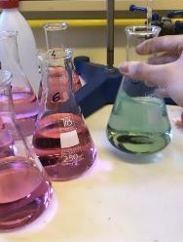
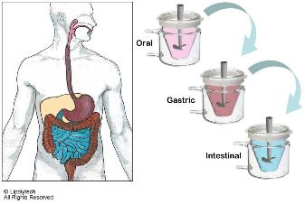
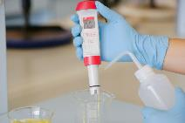
Developing health-protective beverages for the elderly
Determination of their antioxidant capacity
Investigation of the bioaccessability of the polyphenols
Determination of the digestible protein content of beverages
Comparison of the measured crude and digestible protein content of beverages with the regulatory requirements
Notes:
So first of all we wanted to develope something that reduce the incidens of NCDS or lifestyle related chronic diseases.
In addition to determining the raw and digestible protein content of the health-promoting beverages we developing, which are high in antioxidants, protein and fibre, we aimed to test whether our beverages comply with the European regulation, i.e. whether they can be classified as a source of protein and we wanted to investigate the interactions between the individual antioxidant components and the bioaccessability of the antioxidants through an in vitro digestion model.

Slide 6
26,75 g
pseudo-cereal-based drink (quinoa)
10 g red berries (black-berry, raspberry, blueberry, redcurrant)
5 g green tea (Japanese Kukicha green tea)
5 g
chestnut honey
1,75 g
protein (brown rice, pea, hemp)
1,5 g
water-soluble fibre (inulin, pectin)
Brown rice protein: BRF
Pea protein: BF
Hemp protein: KF
Green tea: T
Chestnut honey: M
Red berries: Gy
Quinoa drink: Q
Inulin: I
Pectin: P
Notes:
The slide shows the proportions of the components of the produced complex beverage samples.
the beverages we’ve made were based on our quinoa drink
this was enriched with plant protein (brown rice, pea or hemp protein)
with water-soluble dietary fiber (inulin or pectin)
with antioxidants, in the form of green tea, red berries and chestnut honey, the latters also played a sweetening and a flavoring role
You can also see the labeling of the compontents.

Slide 7
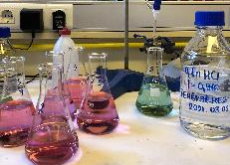
Kjeldahl determination of raw protein content
Protein content (%) = f x (V-Vv) x 0,001401 x K x 100
Kjeldahl determination of crude protein content
CUPRAC (Cupric Ion Reducing Antioxidant Capacity) method
Protein content (%) = f x (V-Vv) x 0,001401 x K x 100
Kjeldahl, J. (1883). Neue Methode zur Bestimmung des Stickstoffs in organ-ischen Körpern. Zeitschrift für analytische Chemie, 22, 366–382. doi: 10.1007/BF01338151
Hsu, H. W., Vavak, D. L., Satterlee, L. D., & Miller, G. A. (1977). A multienzyme technique for estimating protein digestibility. Journal of Food Science, 42(5), 1269–1273. doi: 10.1111/j.1365-2621.1977.tb14476.x
Salgó, A., Ganzler, K., & Jécsai, J. (1985). Simple Enzymic Methods for Prediction of Plant Protein Digestibility. In Amino Acid Composition and Biological Value of Cereal Proteins (pp. 311–323). Budapest: Akadémia Kiadó. doi: 10.1007/978-94-009-5307-9_15
Notes:
After sample preparation, the raw protein content was analysed using the Kjeldahl method.
The digestible protein content was determined by the pH-drop method.
For both methods, 2-2 replicates were used.
Significant differences between groups were tested using ANOVA, pairwise comparisons were tested using the Games-Howell test, and correlation was tested using Pearson's test.

Slide 8
Notes:
The ANOVA results for raw protein content show that BF_I and BRF_P samples show significantly higher values compared to the Q sample.
The measured protein in vitro digestibility clearly shows that the protein content of sample Q is significantly more digestible compared to these three samples. The protein digestibility of all complex beverage samples is not significantly different.

Slide 9
Notes:
In correlation analyses there is an inverse correlation between calculated fibre content and measured protein digestibility in vitro, i.e. the higher the fibre content of the beverage, the less digestible its protein content.

Slide 10
The calculated energy and nutrient content
100 g | Pea ptorein | Brown rice protein | Hemp protein
Energy | 64,1 kcal | 63,4 kcal | 62,8 kcal
Protein | 4,05 g | 4,05 g | 3,00 g
Fat | 0,52 g | 0,43 g | 0,63 g
Carbohydrates -of which sugars | 11,13 g | 11,15 g | 11,19 g
 | 9,18 g | 9,18 g | 9,33 g
Fibre | 4,71 g | 4,69 g | 5,38 g
Protein source:
min. 12% of the total energy requirement comes from protein
Rich in protein:
min. 20% of the total energy requirement comes from protein
Source of fibre:
100 g product contains min. 3 g fibre
Regulation (EC) No 1924/2006 of the European Parliament and of the Council, 2006
Notes:
The proportions of the ingredients in the beverages were determined to meet certain criteria of the relevant European Parliament and Council Regulation, so that the beverages could be considered as a source of protein and fibre.

Slide 11
Ratio of the energy content of the measured digestible protein content to the total energy content
Samples | Digestible protein content calculated from measured protein digestibility | Protein as a percentage of total energy | Rich in protein | Protein source | None of the above
BF_I | 1,96% | 12,5% |  | x
BF_P | 2,33% | 14,91% |  | x
BRF_I | 2,25% | 14,38% |  | x
BRF_P | 2,13% | 13,74% |  | x
KF_I | 1,47%% | 9,62% |  |  | x
KF_P | 1,38%% | 9,02% |  |  | x
Regulation (EC) No 1924/2006 of the European Parliament and of the Council of 20 December 2006 on nutrition and health claims made on foods. In Official Journal of the European Union.
Notes:
Based on our results, BF and BRF samples can be considered not only as a protein source but also as a protein-rich source based on the Kjeldahl raw protein measurement, and KF samples can be considered as a protein source based on the Regulation.
BUT! It is important to note that only a certain percentage of the protein content counted and measured will be digested, so there was a question as to whether the digestible protein content measurement would also meet the criteria set out in the Regulation. The results show that, although the BRF and BF samples are not protein-rich, they do qualify as a protein source, whereas the hemp protein samples do not meet the requirements of the Regulation. The results illustrate the need for tests to determine protein digestibility.

Slide 12
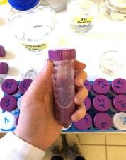
Determination of the antioxidant properties of the plant beverages
Method: in vitro digestion
alfa-amylase pepsin (pH=2) pancreatin + bile salts (pH= 7,5)
Inactivation of the enzymes (4 minutes, 100 °C)
Purification (10 minutes centrifugation, 4000 rpm)
Brodkorb, A., Egger, L., Alminger, M., Alvito, P., Assuncao, R., Ballance, S., …..Recio, I. (2019). INFOGEST static in vitro simulation of gastrointestinal food digestion. Natural Protocols, 14(4), 991-1014. doi:10.1038/s41596-018-0119-1
Notes:
Measuring the antioxidant content of the beverage samples was challenging due to the presence of other nutrients, primarily starch, so we resorted to a less common method, in vitro digestion, which is enzymatically broke down the nutrients from the oral cavity, through the stomach, to the small intestine.
After digestion, the enzymes in the samples were inactivated and then the extracts were purified so that their antioxidant content could be measured.

Slide 13
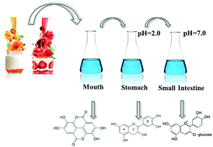
Based on „Influence of honey addition on the bioaccessibility of phenolic contents and antioxidant capacities of different coffee types”
Celep, E., & Yesilada, E. (2017). Influence of honey addition on the bioaccessibility of phenolic contents and antioxidant capacities of different coffee types. Marmara Pharmaceutical Journal, 21(4), 906-914.
Notes:
We also examined the bioaccessability of the antioxidants in the small intestinal stage of in vitro digestion, in which we also simulated small intestinal permeability with a cellulose-based dialysis membrane that allowed the molecules relevant to us to pass.
The solution diffused into the membrane models the substances that diffuse into the serum from the small intestine, that is the bioaccessible substances from there.

Slide 14
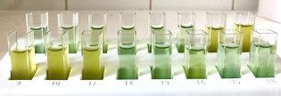
Determination of Total Polyphenol Content (TPC) with Folin-Ciocalteu reagent
CUPRAC (Cupric Ion Reducing Antioxidant Capacity) method
Singleton, V. L., & Rossi, J. A. (1965). Colorimetry of Total Phenolics with Phosphomolybdic-Phosphotungstic Acid Reagents. American Journal of Enology and Viticulture, 16(3), 144 LP-158.
Apak, R., Güçlü, K., Özyürek, M., & Çelik, S. E. (2008). Mechanism of antioxidant capacity assays and the CUPRAC (cupric ion reducing antioxidant capacity) assay. Microchimica Acta, 160(4), 413–419. doi: 10.1007/s00604-007-0777-0
Notes:
Following the digestion, the antioxidant capacity and the total polyphenol content were determined spectrophotometrically.
Total polyphenol content was determined by Folin-Ciocalteu method, total antioxidant capacity by CUPRAC method based on copper reduction.
We used the same statistical analyses as in protein content measurement.

Slide 15
Kjeldahl determination of raw protein content
Protein content (%) = f x (V-Vv) x 0,001401 x K x 100
Notes:
The components of the beverage in the complex mixture interact with each other.
In contrast we’ve expected, we have found that the presence of protein and fiber does not reduce but increases the polyphenol content of the beverages.
For beverages made with different proteins, brown rice proteins had significantly higher polyphenol content than the other two. We achieved the best result with brown rice protein combined with inulin.
Similar results have been obtained in the field of antioxidant capacity.
However, no significant difference can be justified here when using each protein, while in terms of fibers, pectin proved to be better with pea protein.

Slide 16
25.10 %
23.12 %
22.04 %
23.83 %
17.51 %
24.77 %
21.20 %
18.63 %
16.15 %
▪ degree of diffusion (%)
Notes:
Finally, I would summarize the results showing the polyphenol content recovered from the small intestine in the framework of the permeability model study.
Hemp protein, which has the lowest original polyphenol content, is improved by the addition of pectin, while the addition of inulin impairs the serum accessability of polyphenols.
Pea protein also has a lower original polyphenol content, but the addition of pectin and inulin improves the serum accessability of polyphenols.
Brown rice protein has the highest content of original polyphenols, whose serum accessability is not reduced by inulin, but significantly decreased by pectin.
Overall, the best polyphenol diffusion and the highest serum polyphenol levels can be achieved in the small intestine model with the combination of BRF + I.

Slide 17
1.
2.
3.
5.
Results: BRF + I and BF + P beverages seem to be the bests in case of bioaccessibility of antioxidants and digestibility of proteins
Antioxidant properties: increased with the addition of proteins and fibre
Pseudocereal-based beverages: gluten and lactose-free, protein and fibre source, antioxidants, fruit
Bioaccessibility of antioxidants: brown rice protein + inulin is the most favorable
4.
Digestibility of proteins: reduced by fibres
Protein sources: beverages with brown rice and pea protein
6.
Notes:
As a result of my research, we have developed several types of beverages.
In case of antioxidants the beverages have significant antioxidant capacity and the polyphenol content increased with adding protein and fibre sources.
Brown rice protein and inulin are the most favorable in terms of bioaccessability and the amount of antioxidants.
In case of protein content the fibre in the beverages reduced the digestibility of the proteins.
According to the Regulation, beverage samples containing brown rice protein and pea protein can be considered as protein sources in terms of digestible protein content.
Among all samples, the best results in terms of protein digestibility and bioaccessability of antioxidants were obtained with samples BRF_I, BF_P.
The results of my research can serve as a basis for the development of the target beverage. We also would like to add some omega-3 fatty acids and other important nutrients to them.

Slide 18
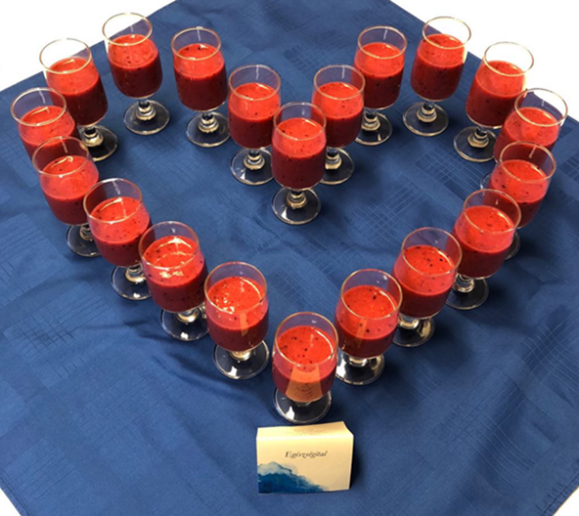
Notes:
Finally, I would like to say goodbye with this picture, which shows the finished beverages, which you will hopefully meet in the future. Thank you very much for your kind attention!

Slide 19
Sign explanation
Q – quino drink
BRF – brown rice protein
BF – pea protein
KF – hemp protein
Gy – red berries
M – chestnut honey
T – green tea
I – inulin
P – pectin
DV – distilled water
PG – „post-gastro”-sample
IN – „in”-sample
OUT – „out”-sample

Slide 20
Enzymatic way
13 mg alpha-amylase + calcium-chloride fill up to 10 ml → 125 microliter of the sample is taken out
1 g sample + 1 g distilled water + 125 microliters alpha-amylase solution
Incubate for half an hour at 37 °C
Adjust pH 2 with 6 M hydrochloric acid
Preparation of pepsin solution (10.3 mg pepsin dissolved in 10 ml of 0.1 M hydrochloric acid) → 160 microliters are added to the samples
Incubate for 2 hours at 37 °C
The samples were adjusted to pH 6 with 1 M sodium-bicarbonate
Preparation of pancreatin + bile salt solution: Dissolve 0.0607 g of pancreatin + 256 mg of bile salt in 10 ml of 0.1 M sodium-bicarbonate solution and add 1.25 ml to the samples
The samples were adjusted to pH 7.5
Incubate for 2 hours at 37 °C
→ The starch is degraded so we can measure the antioxidant capacity of the samples!
(Rufián-Henares & Delgado-Andrade, 2009; Wissam, 2016; Brodkorb et al., 2019)

Slide 21
In vitro-model
In vitro digestion model
Based on the article “Influence of honey addition on the bioaccessibility of phenolic contents and antioxidant capacities of different coffee types”
Main aim: to study the bioaccessability of beverages
Stomach simulation
Preparation of "gastric-juice": 1.6 g of pepsin + 1 g of sodium-chloride mixed in 500 ml of distilled water → adjustment of pH 5 with 5 M hydrochloric acid
17.5 ml “gastric-juice” + 2.5 ml compound plant-based beverage = 20 ml mixture
2 hours incubation in a 37 °C water bath at 100 rpm → gastric peristalsis
Icy bath immediately, 2ml “post-gastro” sample is placed in a refrigerator at -2 °C
Small instestine simulation
Pour 18 ml into a beaker → create a tubular, section-sized cellulose-based (semipermeable membrane) dialysis tube (12kDa)
Pour 1 M sodium-bicarbonate into the “tube” to neutralize the acidic effect → put it in the beaker
Add 4.5 ml of a mixture of 4 mg / ml pancreatin and 25 mg / ml bile salt to the solution in the measuring cup (→18 mg pancreatin and 112.5 mg bile salt)
2 hours incubation in a 37 °C water bath at 100 rpm → intestinal peristalsis
After incubation, the solution outside the dialysis bag (“out” sample) will be neutral in 20-30 minutes → represents substances continuing to the colon
The solution diffused into the dialysis bag (“in” sample) will be the serum → bioaccessible
Samples “OUT” and “IN” are centrifuged in Eppendorf tubes at 16,000 rpm

