Slide 1
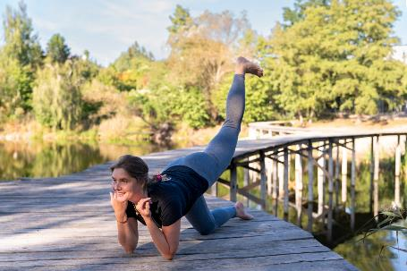
SLAVIC Gymnastic
FOR WOMEN
THE TRADITIONAL SYSTEM OF PSYCHOPHYSICAL ACTIVITY FOR WOMEN’S HEALTH
ELMO
2023
Agnieszka Pluto-Pradzynska, PhD
Lifestyle Medicine Lab & Departament of Immunology
Poznan University of Medical Sciences, Poznan, Poland
Notes:
Chodzi o tym by przy minimum wysiłku uzupełnić braki ruchu. Jesteśmy zwierzęciem stadnym i natura utrzymuje to co ważne dla stada – jednostki, które np. są w stanie przejść 30 km by zdobyć pożywienie. Teraz mamy niedostatki ruchu – czego nie było w paleolicie – dlatego tak ważna jest gimnastyka – czyli w sztuczny sposób musimy uzupełniać ruch, który dawniej był wpisany w czynności życiowe.

Slide 2
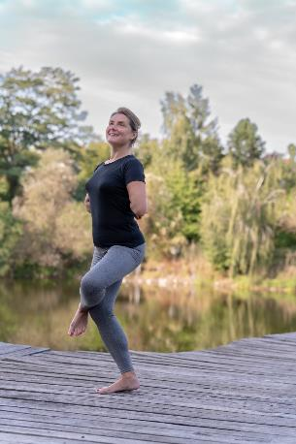
WHY SGW is a kind of psychophysical training?
THE SYSTEM COMBINES:
Physical activity.
Breathing – inhale going into position and exhale when returning.
Energy - if you want to add feeling the flow of energy in the body.
Philosophy - beliefs, relationships
and ancestral practice.

Slide 3
Slavic Gymnastic for Women (SGW)
The system was reconstructed from very limited data - exercises were passed down orally from generation to generation to:
- support women's health,
- prepare their body for pregnancy and childbirth,
- and rapid recovery from puerperium.
In 1999 was published by scientist Dr. Gienadij Adamovich, as a part of student handbook “Traditional methods of psychophysical training” in M. Tank Belarusian State Pedagogical University, Minsk, Belarus .
He taught a lot of women, one of them was my teacher, Oksana Pawlowskaia.
System is promoted in Slavic countries since 2004, in Poland since 2016.

Slide 4
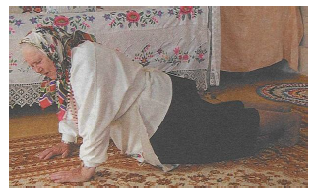
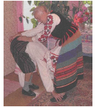
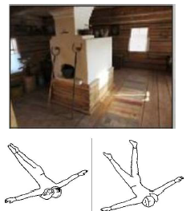
Belarusian women exercising
(10 years ago)
Maria was born in 1937

Slide 5
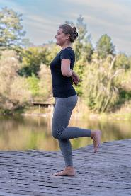
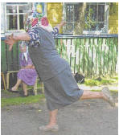
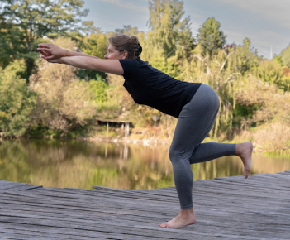
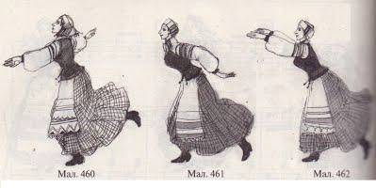
BETWEEN EXERCISES WERE REGIONAL DIFFERENCES
Now
Before
Традыцыйная мастацкая культура беларусаў, Tom 5. Minsk, 2010

Slide 6
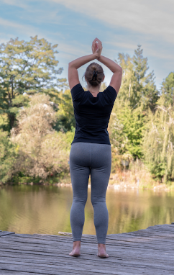
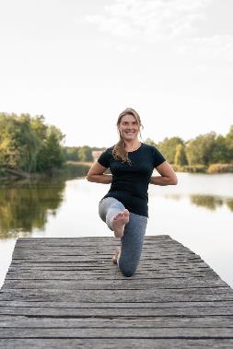
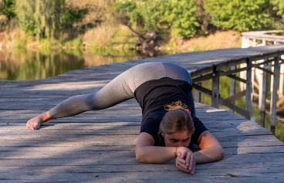
SGW - 27 positions divided into
3 groups - called ‘worlds’
L-1
Standing positions
‘upper world’
Positions on knees
‘middle world’
Positions on elbows & knees
‘lower world’

Slide 7
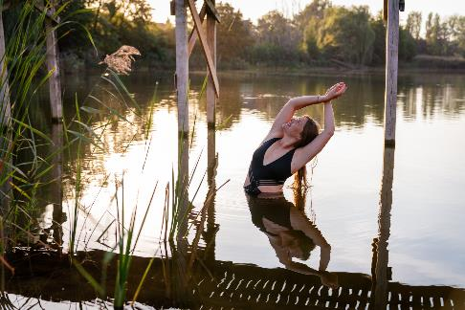
MY inspiration for the study came from OBSERVATIONAL data of women exercising SGW:
Regular practice: 3 times a week for 15 minutes each,
as addition to other daily physical activities helped them to:
strengthen spinal muscles,
improve posture & flexibility,
improve skin condition,
improve metabolism,
regulate menstruations,
lower menopausal symptoms,
heal urinary incontinence,
inner peace,
joy & charm,
women’s support.

Slide 8
The 1st worldwide diagnostic study ON Slavic Gymnastics for Women to verify IMPACT OF regular practice on women’s health.
Age ranges in years | Number of participants
30-33 | 4
42-46 | 4
51 | 1
63 | 1
BASIC:
10 women between the ages of 31 and 63
fully realized all Project criteria.
4 months period of group practice with an insctructor:
70 minutes 2x week + 15 minutes own practice at home 1x week
CLINICAL TRIALS:
Peripheral blood leucocyte analysis
Immune competent cell subsets, autoantibodies(NK, ANA)
Selected sex and stress hormone values (AMH, FSH, LH, Estradiol, Prolactin, Cortisol)
WHOQOL-bref

Slide 9
results of Pilot study
AFTER 4-months training OF SGW
PERIPHERAL BLOOD
LEUCOCYTE ANALYSIS:
Slavic interventions tends
to increase double positive
CD4+/CD8+ cell count,
as well as NK and NKT
cell values (relative and total).
It may reflect higher thymic T-cells output and better T/NK immune surveillance status.
Higher level of activated T lymphocytes count (CD3+HLA_DR+) and decrease level of B lymphocytes CD19+.

Slide 10
results of Pilot study
AFTER 4-months training OF SGW
HORMONAL PARAMETERS:
In half participants was
observed a decrease in
total estradiol concentration.
- it may be due to reduction due to exercise in the amount
of subcutaneous fat, which is a non-ovarian source of estrogen.
- or due to an increase in hormone-binding protein.

Slide 11
results of Pilot study
AFTER 4-months training OF SGW
Prolactin changes were
not always related to
menopause.
In 1participant we observed
decrease in FSH levels and an increase in estradiol.
TSH increase after the examination in subjects with features of subclinical hypothyroidism.

Slide 12
important
Circadian rhythm and daily oscillations in gene expression, metabolism, activity and hormone levels are crucial for fertility.
The proper functioning of these mechanisms is important:
for the peak in LH concentration immediately preceding ovulation
and inducing changes that cause the rupture of the walls of the dominant follicle, resulting in the formation of the corpus luteum and the production of progesterone.
It was observed & interviewed :
better mood, better posture and flexibility,
improve of skin condition,
more regular menstruation,
more satisfaction in intimacy.
,,

Slide 13
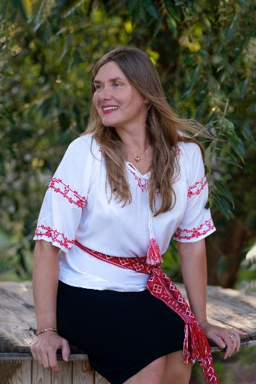
limitations of the Pilot study ON SGW
Limitations of the study:
The small group and large age spread, including 3 menopausal patients:
show possible trends,
can not be the basis for clear conclusions for hormonal parameters related to the gonad-pituitary axis (estradiol, LH, FSH, prolactin).

Slide 14

Pilot study Team & details → paper:
Slavic Gymnastics for Women - evaluation of selected parameters of immune system and hormonal balance in a group of exercising women. A pilot study
Agnieszka Pluto-Pradzynska, PhD – manager in Health Sc.
Mateusz Madejczyk, MD, PhD – gynecologists, immunologists
Grazyna Baczyk, PhD - nurse
Prof. Grzegorz Dworacki, MD, PhD – pathmorphologists, immunologists
DOI: coming soon in:

Slide 15
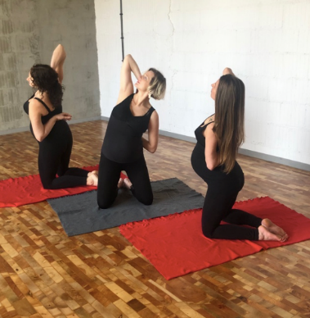
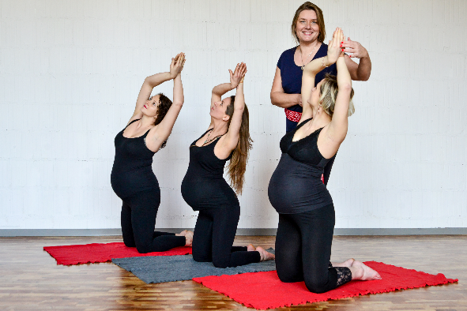
Slavic gymnastic prepares women for: pregnancy, childbirth and rapid recovery from the puerperium

Slide 16
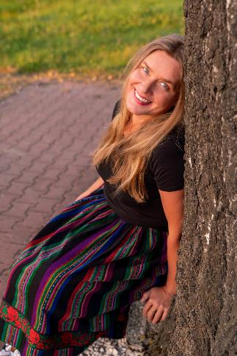
Thank you for your Attention
Agnieszka Pluto-Prądzyńska, PhD
Tel. +48 662 003 983
agapp@ump.edu.pl
Lifestyle Medicine Lab - Departament of Immunology
Chair of Pathomorphology and Clinical Immunology
Poznan University of Medical Sciences, Poznan, Poland
Thanks to:
Tricia Photography - Patrycja Oleszynska
https://www.instagram.com/tricia_photography/

Slide 17
