Slide 1
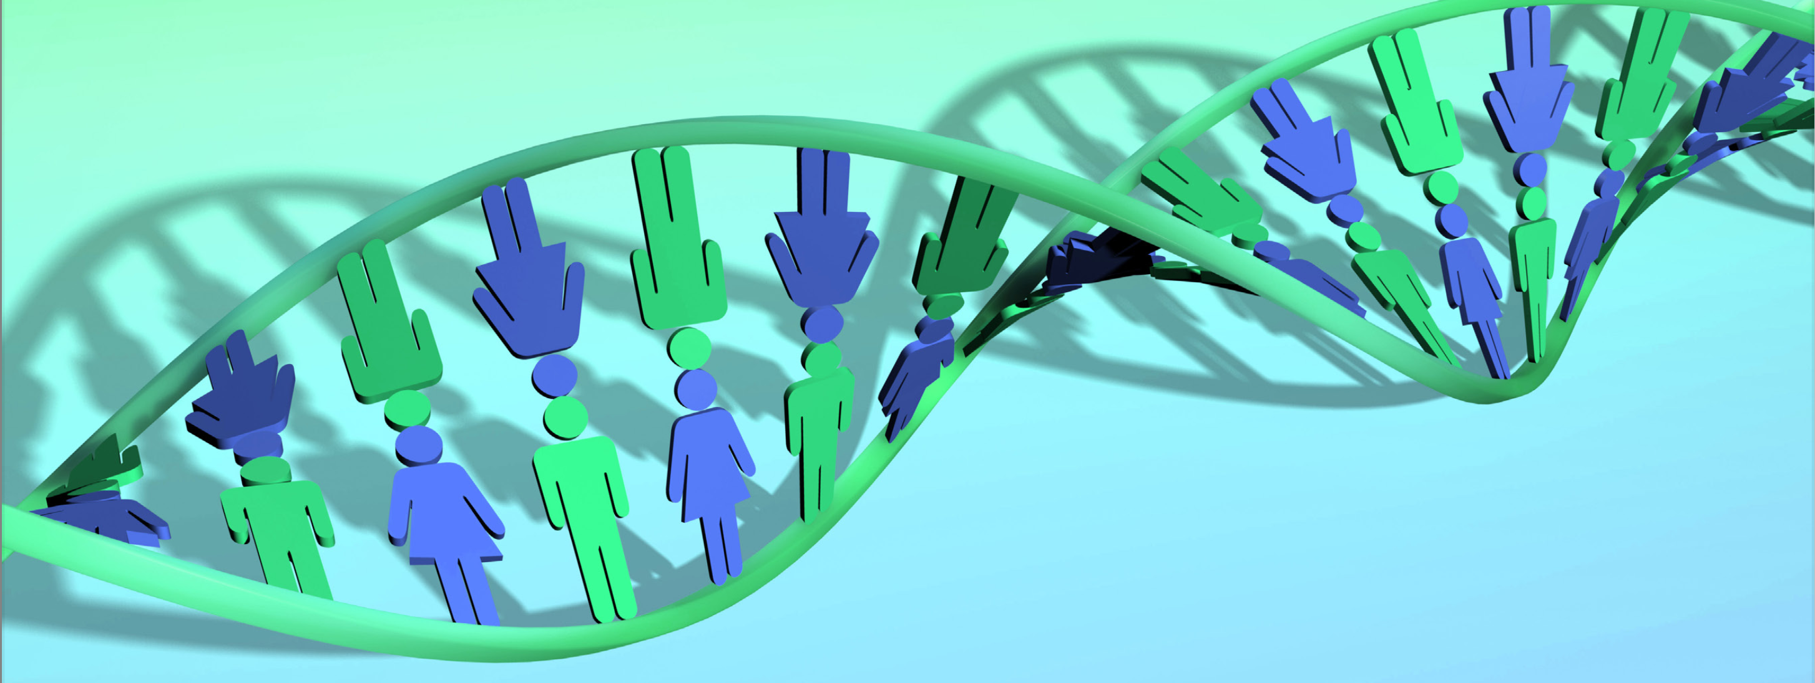
Epigenetics and lifestyle
Dr. Pedro Luis González-Sanz
ELMO Country Representative -Spain
Sec. Gnral. Spanish Lifestyle Medicine Institute
Preventive and Personalised Lifestyle Medicine - Blue Healthcare Clinic
Towards personalized lifestyle medicine
November 2023 5th ELMO CONGRESS - BUDAPEST

Slide 2
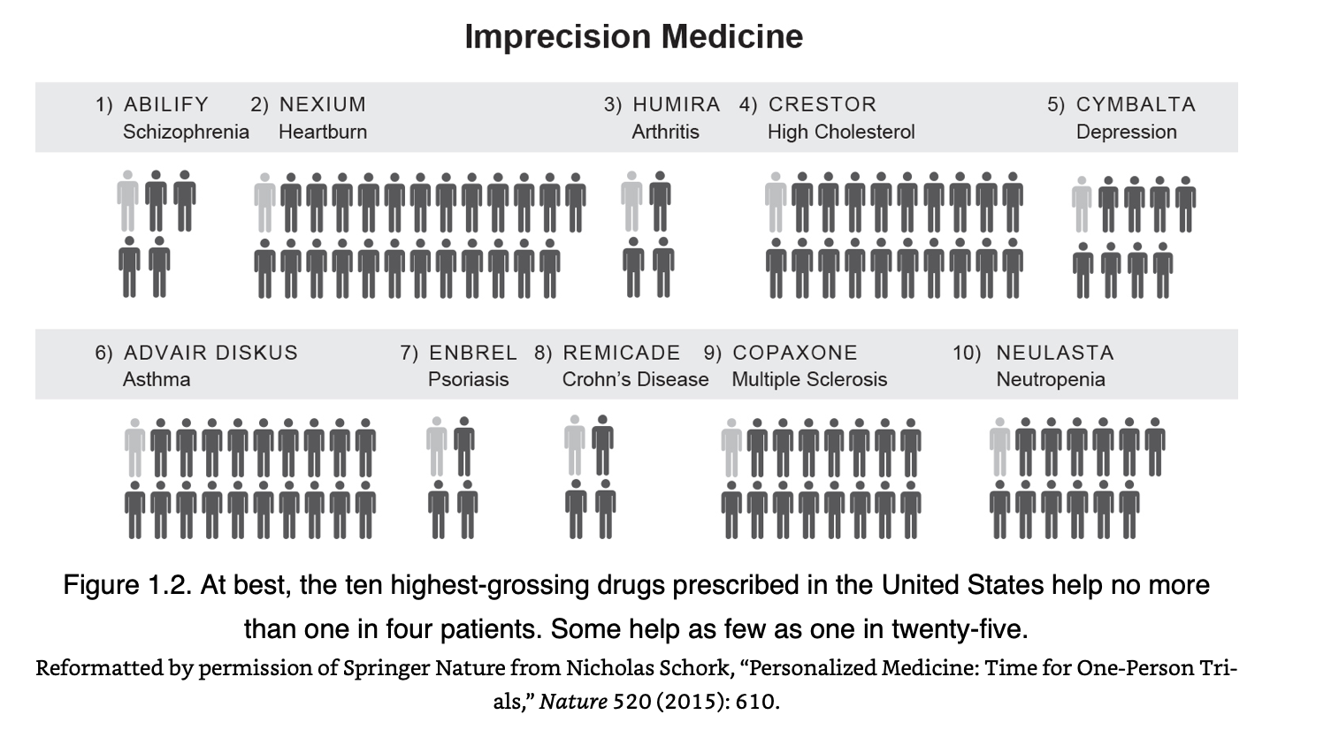

Slide 3
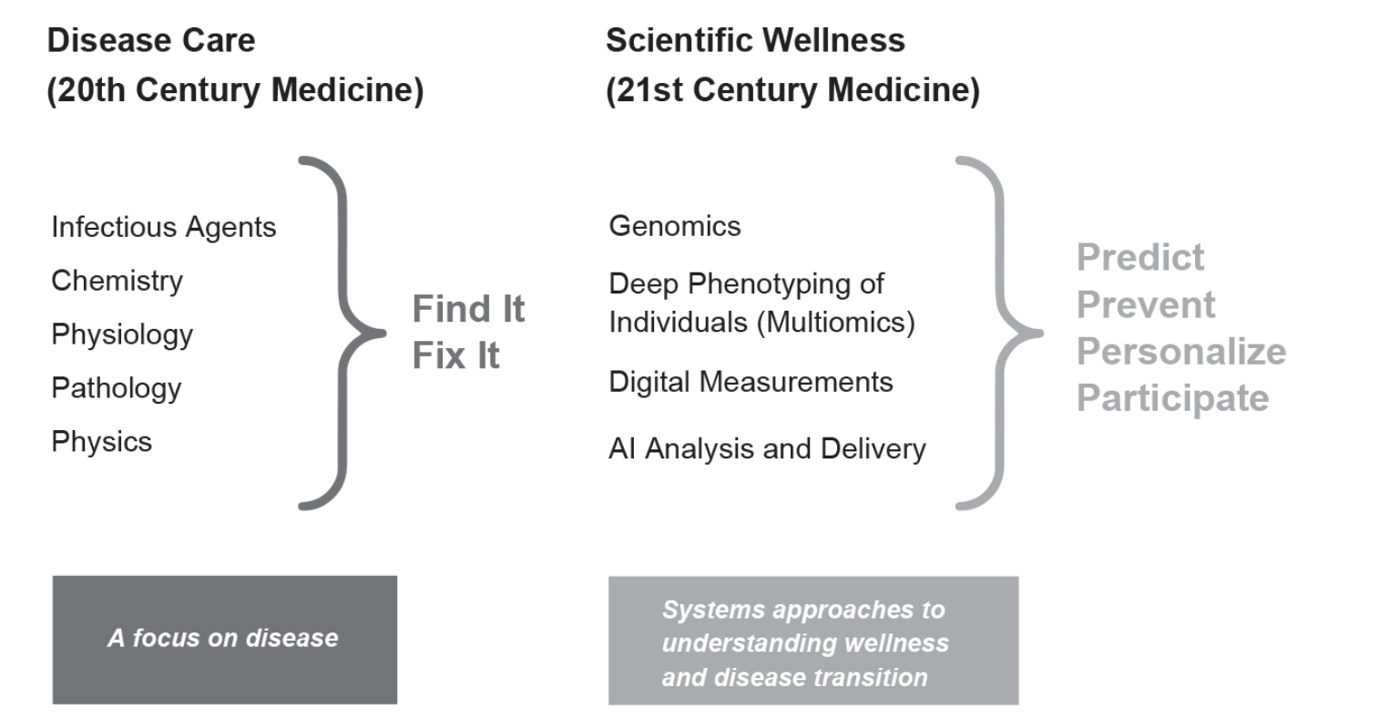

Slide 4
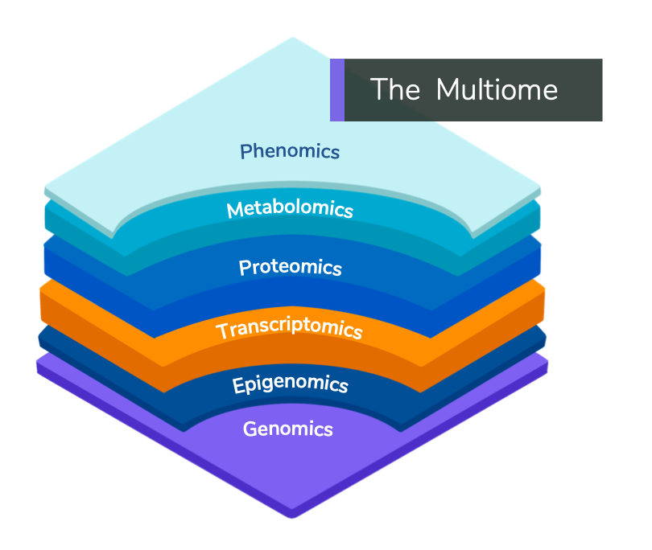
Epigenetics & Transcriptomics

Slide 5
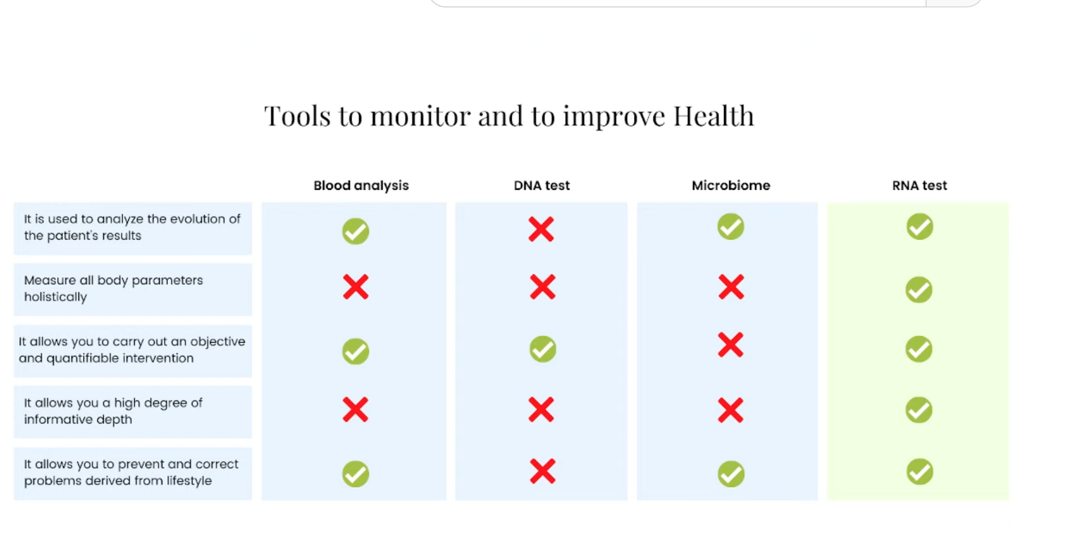

Slide 6
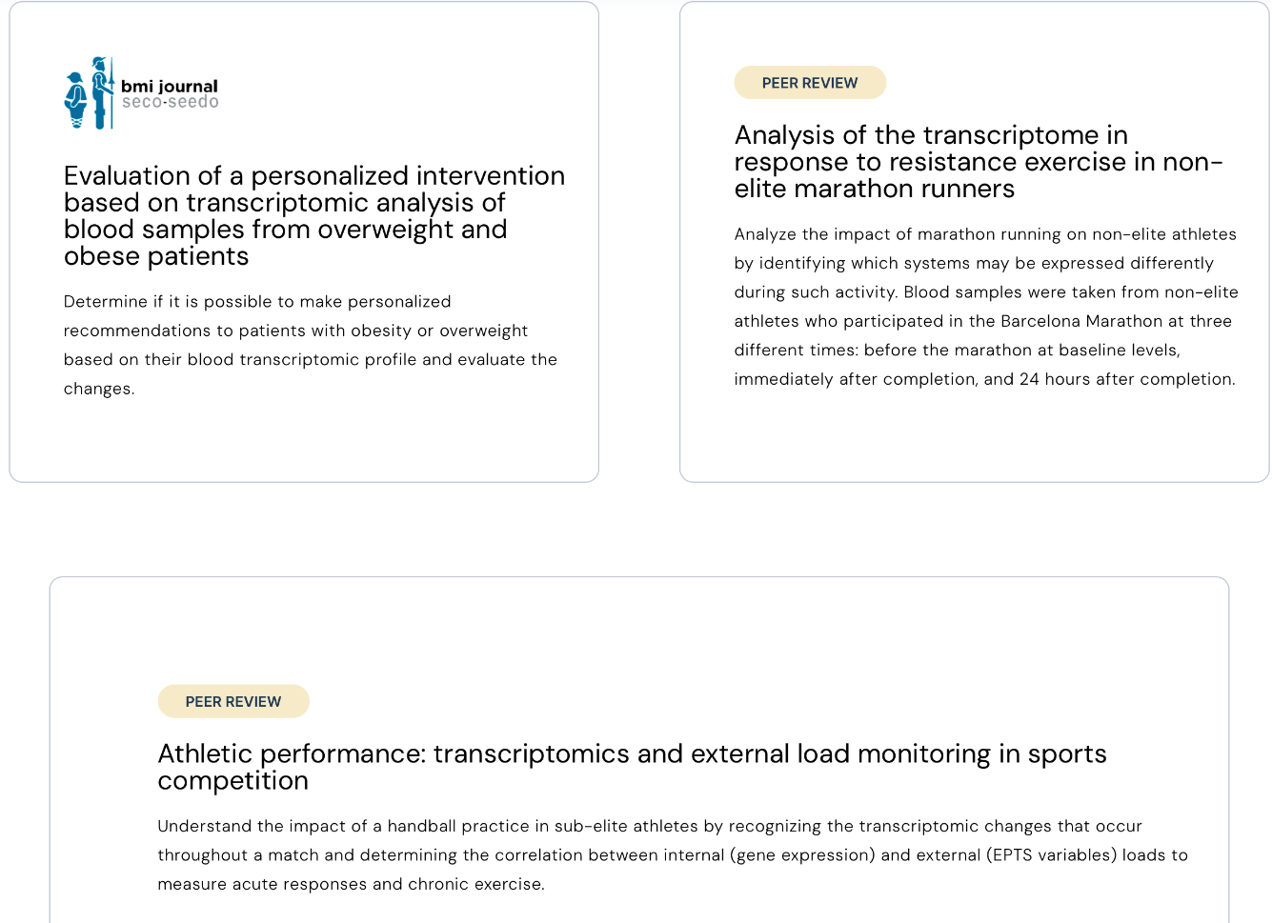
RNA EPIGENETIC TEST - BEYOND YOU (SANT PAU HOSP. MOLECULAR BIOLOGY DEPT)
20 years of research in two large institutions, the Hospital Sant Pau and the Universitat Politècnica de Catalunya.

Slide 7
PRECISION MEDICINE THROUGH AI
Metabolic pathways
Analysis of RNA levels to examine the expression of all genes in the whole genome associated with over 360 metabolic pathways with just a blood sample
Mitochondrial disfunction
Altered intercellular communication
Genomic instability
Telomere shortening
Epigenetic alterations
Lose of prosteosthasis
Nutrient dysregulation
Warned out stem cells
Cellular senescence

Slide 8
PRECISION TOOL FOR PERSONALIZED LIFESTYLE MEDICNE

Slide 9
Lifestyle modulates the epigenome

Slide 10
Lifestyle is associated with changes
in epigenetic clocks

Slide 11
Uses of epigenetics in LFM

Slide 12
Mental health interventions

Slide 13
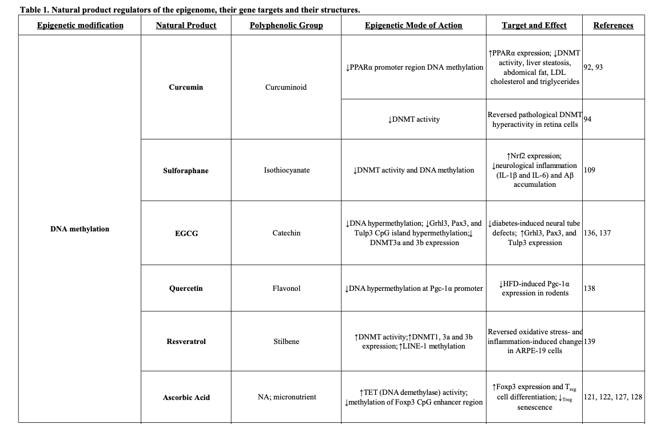
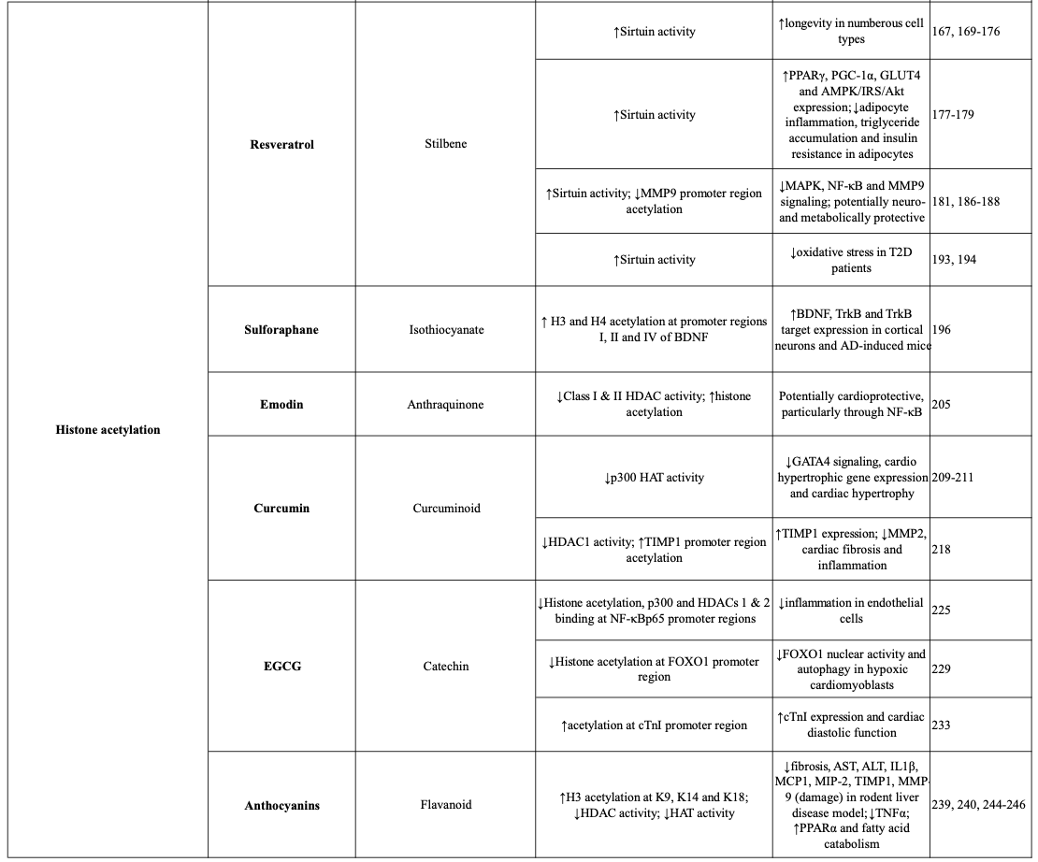
Food interventions through nutrients regulating the epigenome

Slide 14
Lifestyle intervention planning and adaptation

Slide 15
Lifestyle intervention follow-up

Slide 16
THE CLINICAL UNDERSTANDING IS ONLY BEGINING…

