Slide 1
Fibromyalgia
Chronic pain –
a syndrome or a disease?
Dr Comsa Delia
Rheumatologist
HIS-IRIS SUD Bruxelles

Slide 2
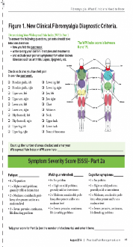
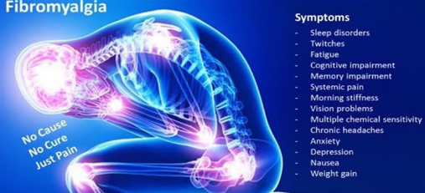
Pain is classically defined as an unpleasant sensory or emotional experience associated with actual or potential tissue damage (Raja et al., 2020)
Chronic pain is pain that persists or recurs for longer than 3 months.
Fibromyalgia (FM) is a condition that causes pain all over the body (also referred to as widespread pain), sleep problems, fatigue and emotional and mental distress.

Slide 3
Fibromyalgia is considered a disorder of pain regulation, classified under central sensitization (Schmidt-Wilcke T-2011)
Central sensitization is defined as “an amplification of neural signaling within the central nervous system that elicits pain hypersensitivity” and “increased responsiveness of nociceptive neurons in the central nervous system” ^{(Woolf CJ 2011)}
Functional magnetic resonance imaging (fMRI) showed supraspinal-mediated multisensory hypersensitivity (insula activation by an aversive visual stimulus -Harte et al. 2016).
Notes:
Abnormalities noted in fibromyalgia include
- elevated levels of the excitatory neurotransmitters like glutamate and substance P
- diminished levels of serotonin and norepinephrine in the descending anti-nociceptive pathways in the spinal cord
- prolonged enhancement of pain sensations
- dysregulation of dopamine
- alteration in the activity of brain endogenous opioids.
This explaines the developement of new nociceptive pathways (tactile allodynia), the spreading of pain outside the area of the injury (secondary hyperalgesia) and the increase response to repeated inputs (temporal summation).
In addition to hypersensitivity to painful stimuli, there is accumulating evidence that many patients with central sensitization exhibit hypersensitivity to nonpainful stimuli that bypass peripheral and spinal pathways. Patients with FM demonstrate perceptual amplification of auditory stimuli, and rate everyday sounds as more unpleasant compared to controls
Functional magnetic resonance imaging (fMRI), in conjunction with QST, has been used to further demonstrate that patients with central sensitization exhibit a supraspinal-mediated multisensory hypersensitivity. We recently found that the insula was activated by an aversive visual stimulus, and that the degree of activation was strongly associated with patients’ self-reported FM pain (Harte et al., 2016).
In addition to sensitivity to visual stimuli, methods such as fMRI clearly demonstrate that individuals with FM display increased brain activity when given a mild pressure or heat stimulus that most individuals would feel as “touch” or “warmth,” rather than “pain.” This indicates that individuals with central sensitization have a similar brain response to painful stimuli as controls, but at lower levels of stimulus intensityMoreover, this activity within the insula was reduced following administration of pregabalin (but not placebo), and the analgesic effectiveness of this drug was associated with a concomitant reduction in the insula's response to the visual stimulus.

Slide 4
What can we do?
Chemical
Polypharmacy is a very frequent strategy in chronic pain but is also the variable which best contributes to poor quality of life – side effects, highly costs, opioids addiction (Cheng S – BMC Geriatrics 2020)
Notes:
Polypharmacy is a very frequent strategy in chronic pain but is also the variable which bnest contributes to poor quality of life – side effets, higly costs, opioids addiction
confront patients with movements and daily activities that are feared, avoided and/or painful, with the aim of deceasing fear of these movements and activities

Slide 5
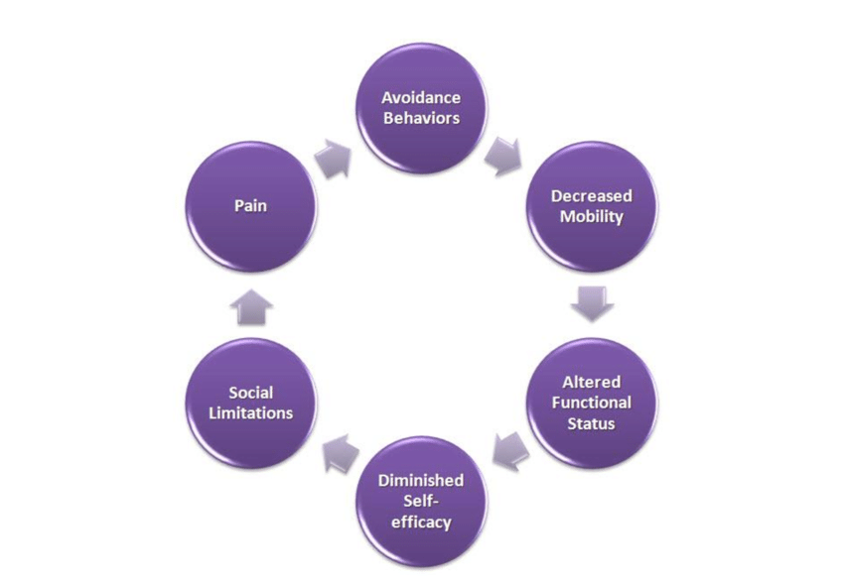
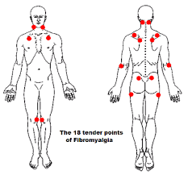
Physical status
Reconditioning - reduction of pain and depression
- improvement in global health and physical function (Curr Pain Headache Rep. 2011)
New data - cognition-targeted exercise therapy
- trigger points therapy
Aerobic Exercise Versus Combined Exercise Therapy in Women With Fibromyalgia Syndrome: A Randomized Controlled Trial - ScienceDirect
Effect of different types of exercise in adult subjects with fibromyalgia: a systematic review ( 20 June 2022 -nature.com)

Slide 6
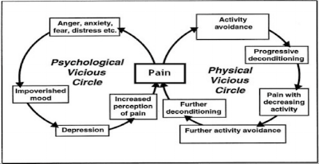
Emotional status
Treating associated conditions - depression and anxiety
Behavioural status
- pain neuroscience education (PNE)

Slide 7
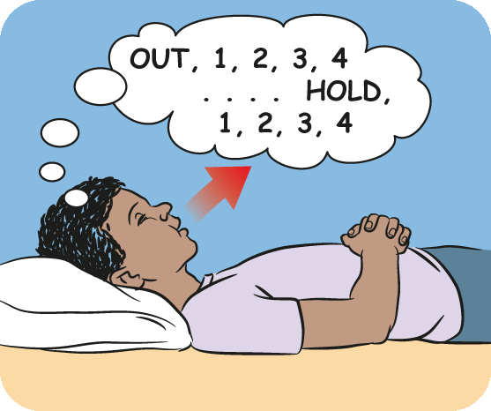
Behavioural status
1. Adapting diet – low protein intake and lack of regular exercise are associated with high odds for low back pain in women
- people experiencing pain generally consume more calories, added sugars, saturated fatty acids, sodium, and caffeine
- in FM seven clinical trials were identified (Silva 2019) but they had poor statistical quality
2. Treating sleeping problems (OSAS was detected in 50% of patients with FMS – Handan 2017 and 33% of people with fibromyalgia experienced symptoms of RLS)
- Mindfulness
- Meditation
- Respiration tehniques
- Rocking chair
Noh H - Clin. Med. 2022;11:1220. doi: 10.3390/jcm11051220
Meleger A.L - PM R. 2014;6:7–12.e11

Slide 8
Pain neuroscience education
Acceptation
Understanding
Addressing family
Stop feeling guilty
See the half full glass
Finding the primary and secondary trigger(s)
Notes:
Important to know that pain is a message to protect you from outside danger so not dangerous
Change the perception of pain nd help ythem change the things that are in their control and help the chznge behaviour

Slide 9
Conclusion
Fibromyalgia equals central sensitisation
Multidisciplinary approche is needed for the treatment
Behavioural tips
PNE should be a part of the first line treatment

Slide 10
THANK YOU!

