Slide 1
Ways to identify female sexual dysfunction Csaba Erdős University of Szeged, Albert Szent-Györgyi Medical School

Slide 2
Sexual Health
„Sexual health is a state of physical, emotional, mental and social well-being in relation to sexuality; it is not merely the absence of disease, dysfunction or infirmity.”
Information
Sexual health
Knowledge about risks
Sexual health care
Supportive environment
General health
World Health Organization. Sexual Health.

Slide 3
Sexual dysfunction, quality of life
Sexual dysfunctions
Hopelessness, frustration, anger
Poor health (self-report)
Anxiety, depression
Low self-esteem
Mulhall J et al. Importance of and satisfaction with sex among men and women worldwide: results of the global better sex survey. 2008.

Slide 4
Aetiology of female sexual dysfunction
Female sexual dysfunction
Early pornography
Negative sexual experience
Negative self-image
Sexual abuse
Brassil D F, Keller M. Female sexual dysfunction: definitions, causes, and treatment. 2002.

Slide 5
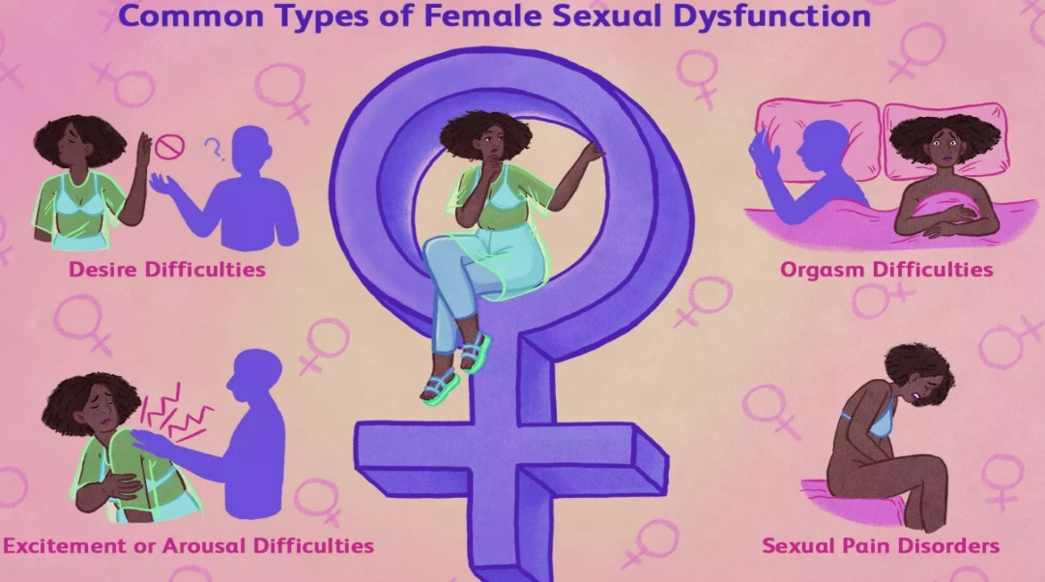
Female sexual dysfunction (DSM-5, 2013)
Female orgasmic disorder
Female sexual arousal/interest disorder
Genito-pelvic pain/penetration disorder
American Psychiatric Association. (2022). Sexual dysfunctions. In Diagnostic and statistical manual of mental disorders (5th ed., text rev.)..

Slide 6
Morbidity of female sexual dysfunction
Occurrence of at least one sexual disorder: 40-50%¹
Female sexual arousal/interest disorder: 8-55%²
Female orgasmic disorder: 20-40%³
Genito-pelvic pain/penetration disorder: 3-6%⁴
1: McCabe et al. Incidence and Prevalence of Sexual Dysfunction in Women and Men: A Consensus Statement from the Fourth International Consultation on Sexual Medicine, 2015.
2: Lewis RW et al. Epidemiology/risk factors of sexual dysfunction. 2004
3: Bradford A. Female orgasmic disorder: Epidemiology, pathogenesis, clinical manifestations, course, assessment, and diagnosis 2014.
4: Hayes RD What can prevalence studies tell us about female sexual difficulty and dysfunction? 2006.

Slide 7
Diagnostic criteria of female orgasmic disorder
Criterion A:
1. Marked delay, infrequency or absence of orgasm. / 2. Marked reduction of orgasmic sensations.
Criterion B: Symptoms in criterion A have persisted for at least about 6 months.
Criterion C: Symptoms in criterion A cause clinically significant distress in the individual.
Criterion D: Exclusion of mental disorder, distress and effects of substance/medication.
American Psychiatric Association. (2022). Sexual dysfunctions. In Diagnostic and statistical manual of mental disorders (5th ed., text rev.)..

Slide 8
Criteria of female sexual arousal/interest disorder
Criterion A: Significant reduction or absence of sexual interest or arousal, manifested by at least three of the following:
Reduction or absence of interest in sexual activity.
Absent/reduced sexual/erotic thoughts or fantasies.
No/reduced initiation of sexual activity, and typically unreceptive to a partner’s attempts to initiate.
Absent/reduced sexual excitement/pleasure during sexual activity in almost all or all (approximately 75%–100%) sexual encounters.
Absent/reduced sexual interest/arousal in response to any internal or external sexual/erotic cues (e.g., written, verbal, visual).
Absent/reduced genital or nongenital sensations during sexual activity in almost all or all (approximately 75%–100%) sexual encounters (in identified situational contexts or, if generalized, in all contexts).
Criterion B
Criterion C
Criterion D
American Psychiatric Association. (2022). Sexual dysfunctions. In Diagnostic and statistical manual of mental disorders (5th ed., text rev.)..

Slide 9
Criteria of genito-pelvic pain/penetration disorder
Criterion A: One (or more) of the following is a persistent or recurrent difficulty:
Vaginal penetration during intercourse.
Marked vulvovaginal or pelvic pain during vaginal intercourse or penetration attempts.
Marked fear or anxiety associated with vulvovaginal or pelvic pain at the thought of, during, or as a result of vaginal penetration.
Marked tension in the pelvic muscles during attempts at vaginal penetration.
Criterion B
Criterion C
Criterion D
American Psychiatric Association. (2022). Sexual dysfunctions. In Diagnostic and statistical manual of mental disorders (5th ed., text rev.)..

Slide 10
Aims of the study
Prevalence of female sexual dysfunction
Aims
of the study
Application of DSM-5 criteria
Raising awareness, breaking taboos

Slide 11
Methods
Cross-sectional study
Online questionnaire
Aged 18-35 years
IBM SPSS 28.0
Mann-Whitney U test
Normality test: Kolmogorov-Smirnov test
Chi-square test
Significance: p<0.05

Slide 12
Method
Total population
N=9397
Females
N=5942
NO
Criterion A
Control group
N=2120
YES
NO
Criterion B
YES
NO
Intermediate group
N=2611
Criterion C
YES
NO
Criterion D
YES
FSIAD
N=100
FSD
N=1211
FOD
N=547
GPPPD
N=276
MFSD
N=288

Slide 13
Results Orgasmic disorder (n=547)
1-10 Scale
p<0.05

Slide 14
Results Female sexual arousal/interest disorder (n=100)
1-10 Scale
p<0.05

Slide 15
Results Genito-pelvic pain/penetration disorder (n=276)
1-10 Scale
p<0.05

Slide 16
Results Multiple disorder (n=288)
1-10 Scale
p<0.05

Slide 17
Lifetime prevalence of STD (%)
p<0.05

Slide 18
Lifetime prevalence of sexual abuse (%)
p<0.05

Slide 19
Summary
Our study was the first to use the DSM-5 criteria in a large population to assess female sexual dysfunction.
We were able to assess a broad population.
The previous etiological aspects were confirmed by our survey.
Risk factor:
Early consumption of pornographic content
Early negative sexual experience

Slide 20
Conclusion
Anonymous survey makes it easier to share information about sexual problems.
This questionnaire can provide a broad measure of sexual dysfunction → More information about prevalence.
Easier to detect the aetiology associated with sexual dysfunction.
Sexual health education – Possibility of early detection of dysfunction.

Slide 21
Thank you for your attention

