Slide 1
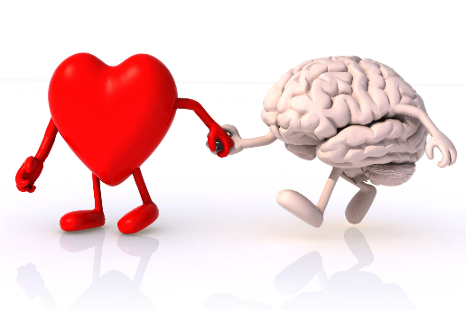
Lifestyle Medicine for the
Heart and Brain

Slide 2
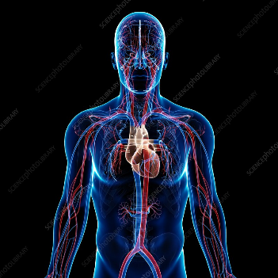
LINKS BETWEEN HEART AND BRAIN
Vascular diseases account for 30% premature deaths (CAD) worldwide Causes include BP, Lipids, Diabetes, AF, Lifestyle pillars More strokes in women due to BMI.
80% chronic diseases are preventable (20% genetic) – Inter-heart Study
90% world population are unhealthy (AHA Essential 8) Lifestyle behaviours that impact heart health also affect brain health - Alzheimer’s Disease, Long Covid Illness. Whole Health includes emotional, psychological, mental and physical health and not merely absence of disease

Slide 3
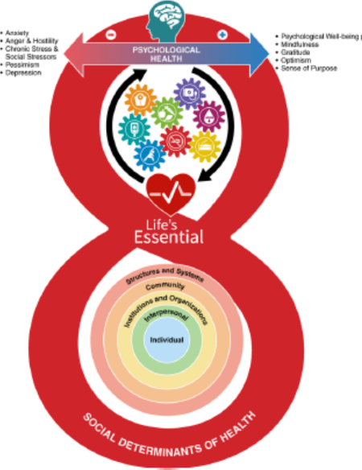
Life’s Essential 8: Updating and Enhancing the American Heart Association’s Construct of Cardiovascular Health: A Presidential Advisory From the American Heart Association
Donald M. Lloyd-Jones, Norrina B. Allen, Cheryl A.M. Anderson, Terrie Black, LaPrincess C. Brewer, Randi E. Foraker, Michael A. Grandner, Helen Lavretsky, Amanda Marma Perak.
Originally published29 Jun 2022https://doi.org/10.1161/CIR.0000000000001078Circulation. 2022;146:e18–e4
SDOH, Cai JACC 2023

Slide 4
Lifestyle Medicine
Lifestyle medicine is a branch of medicine which has as goal to maintain optimal health and to prevent, treat and reverse chronic illness across all life stages.
The health interventions used in lifestyle medicine include evidence based behavioural strategies, while considering equity and sustainability, to enhance self-management skills for optimizing nutrition, sleep hygiene, stress management, social connection, sexual health and fertility, physical activity and minimizing substance use and environmental exposures
Causes 80% reversible chronic diseases worldwide
Pillars
Addictions (smoking / alcohol / drugs)
Nutrition / Healthy Eating
Physical Activity
Sleep
Stress/Emotional wellbeing
Social Connectedness
Sexual Health & Fertility
Environment

Slide 5
What causes chronic disease?
Journal of the American College of Association Between a Social-Business Eating Pattern and Early Asymptomatic Atherosclerosis JACC 2016
Relation between resting amygdalar activity and cardiovascular events: a longitudinal and cohort study
Dr Ahmed Tawakol, Lancet 2016 2017
Social isolation: predictor of mortality comparable to traditional risk factors. Pantell. Am J Public Health 2013;
Foster BMC Medicine 2023
PURE Study Lancet 2017
Exercise and acute cardiovascular events
Circulation 2007
Sleep duration and MI JACC 2019
Sleep and AF JACC 2023
TV viewing and mortality AusDiab study.Circulation 2010
Same applies to CVD, AD, Cognition

Slide 6
PREVENTING AND TREATING VASCULAR DISEASE
Journal of the American College of Cardiology
Volume 67, Issue 3, January 2016
Exercise at the Extremes
The Amount of Exercise to Reduce Cardiovascular Events
Thijs M.H. Eijsvogels, Silvana Molossi, Duck-chul Lee, Michael S. Emery and Paul D. Thompson
Lancet. 1990 Jul 21;336(8708):129-33.
Can lifestyle changes reverse coronary heart disease? The Lifestyle Heart Trial.
Ornish D1, Brown SE, Scherwitz LW, Billings JH, Armstrong WT, Ports TA, McLanahan SM, Kirkeeide RL, Brand RJ, Gould KL.
Eur J of Card Prevention & Rehab 2005. Relaxation for rehabilitation and prevention in ischemic heart disease. White et al.
Primary care-led weight management for remission of type 2 diabetes (DiRECT): an open-label, cluster-randomised trial
Lancet 2017
Whole Food Plant based Diets + Mediterranean Diet studies all show less MI / cancer / strokes & better outcome
JACC 2017 Satiija; BMJ Sofi 2008; Annual Review of Public Health Willet 2013. Mayo Clin Proceedings 2023.
Real benefit is a combined pillars approach

Slide 7
Lifestyle Medicine can lower the risk of vascular disease
Medications may be part of solution but that won’t change behaviours

Slide 8
Behaviour is a Miracle Drug Time Magazine August 31, 2023
“Healthcare is broken. Chronic diseases are eating up an increasing share of healthcare resources in every healthcare system across the world in ways that are not sustainable. Yes, there is a golden age of innovation happening in the form of new technologies like gene therapy, neural technology, immunotherapy, and increasingly the impact of AI on diagnoses and drug development, but we can’t let these extraordinary technological advances blind us to the tragedy of modern healthcare and to the much-neglected miracle drug right in front of us: our daily behaviours. Whether for preventing disease or optimizing the treatment of disease, behaviour is indeed a miracle drug”
Ariana Huffington Thrive Global

Slide 9
KNOWING DOING
Heart –Brain Health
70% risk is preventable (lifestyle pillars)
WHO definition – not just physical health
Challenge is what is stopping me?
Is it important to change and if not do I realise consequences?
How to change?
Mindset / Emotional health
Habits
Accountability
Coaching
Act – patient, community, pillar

Slide 11
Behaviour Medicine - Habits
Goals, Identify behaviours, Monitor + Measure
Make habit so small (micro) that you cannot fail
Trigger / Prompt / Reminder – “ after I….
Behaviour / Action– “ one step – really small, easy”
Celebrate – emotion is making behaviour a habit. Must do it immediately. Fun. Enjoy. With others. Feeling drives habits.
Develop your GRATITUDE Habit

Slide 13
Small steps to BIG Health Improvements

Slide 14
Small starting steps to better Heart & Brain health and function

Slide 15
Do you think that the RK Cardiology Lifestyle programme has positively impacted on your understanding, awareness and approach to the following?
90%
80%
70%
60%
50%
40%
30%
20%
10%
0%
83%
67%
50% 50%49%
58%
33%
32%
34%
17%
9% 8%
8%
1%
1%
Food & Diet
Exercise Habits
Sleep
Stress Levels
Your Performance at
Work
Strongly Agree
Agree
Neither Agree nor disagree
Disagree
Strongly Disagree
Drrobertkelly.ie

Slide 16
Summary
Brain and Heart are closely connected in all aspects of health
Heart and Brain diseases are commonest causes for premature death, 80% of which are lifestyle driven and potentially preventable.
Shared Chronic diseases of Hypertension, Diabetes, Obesity, Atrial Fibrillation.
Lifestyle Medicine is therefore essential for brain and heart health & longevity
We all know this, but we need to take that medicine every day!
As with all change, a simple easy effective tool helps – Tiny Habits.
Sustaining behaviour change will only happen if we enjoy (mindset) doing the new behaviours every day!
Happy BRAIN -> Happy HEART -> Happy, Healthy, Longer Life.

