Slide 1
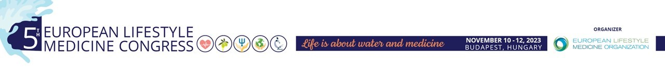
Lifestyle Medicine Congress - 2023 Budapest
Nerella Chauvin-Némethy
BioNeuro Clinic - Budapest, Hungary
Lifestyle Medicine - Stressmanagement
Biofeedback - Neurofeedback
HRV biofeedback, sEMG biofeedback, Stressprofile
Neurofeedback (Frequency Band and SCP - Slow Cortical Potentials)
Chauvin N. Nerella - BioNeuro Klinika
biofeedbackneurofeedback.hu

Slide 2
Why is lifestyle medicine important in ergotherapy? Where do they connect?
Ergotherapy - Occupational Therapy (OT)
Occupational Therapy is the branch of rehabilitation whose main aim is to achieve maximum possible autonomy of the patient and the most complete integration into the family, the work and the society.
Occupational Health is NOT Occupational Therapy
Occupational safety and health (OSH) also known simply as occupational health is a multidisciplinary field concerned with the safety, health and welfare of people at work.
Chauvin N. Nerella - BioNeuro Klinika
biofeedbackneurofeedback.hu

Slide 3
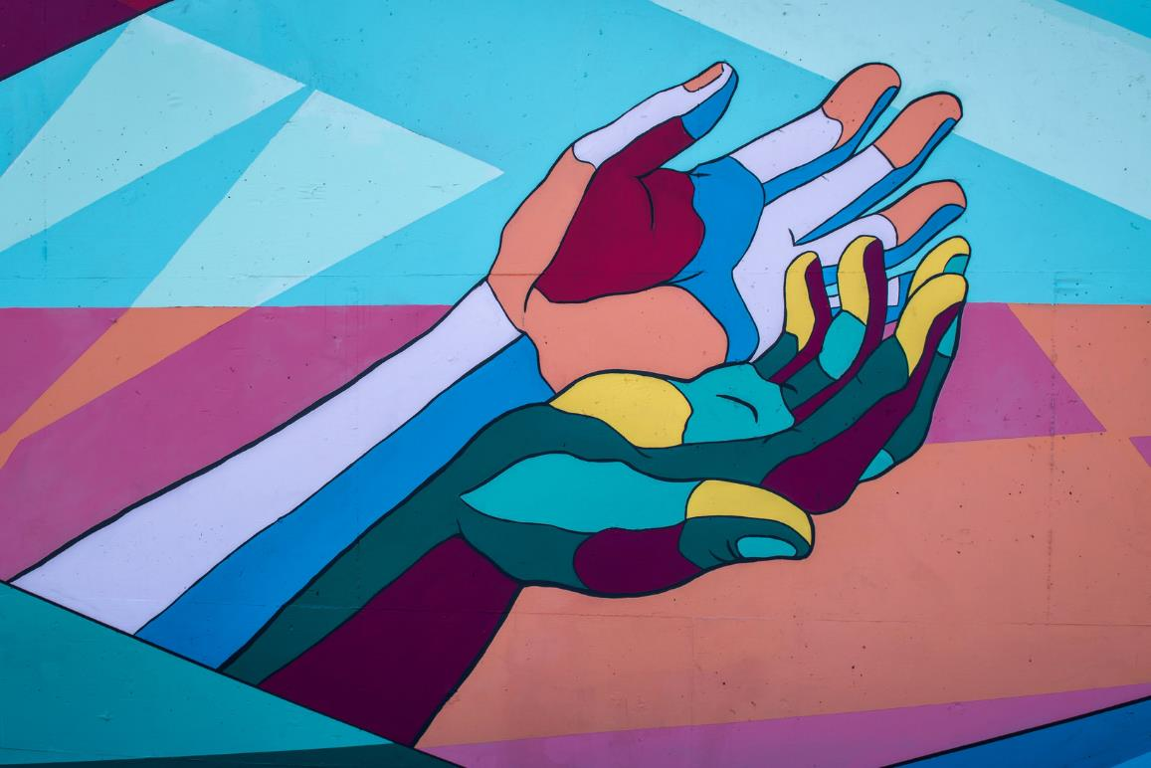
Occupational Therapy Ergotherapy
1. Mental Health OT
2. Physical Rehabilitation Therapist
3. Hand Therapist
4. Driving and community mobility
5. Environmental Modification
Chauvin N. Nerella - BioNeuro Klinika
biofeedbackneurofeedback.hu

Slide 4
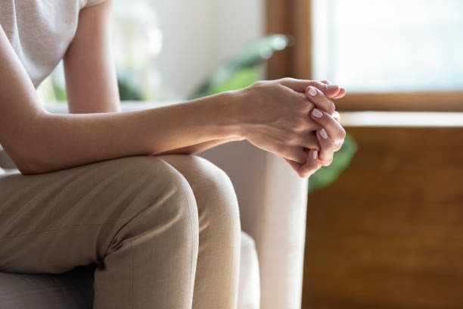
1. Mental Health OT
Work with individuals, whose lifespan issues or relevant conditions are impacting their occupational performance, related to mental health.
Difficulty problem solving - emotional regulation - stress.
Work on strategies or adaptations to set them up for success to combat these challenges and to make them as productive as possible in their activities daily living.
A mental health OT is using all pillars of lifestyle medicine. Stressmanagement, plant predominant nutrition, regular physical activity, a good restorative sleep, avoidance of risky substances and positive social connections.
Chauvin N. Nerella - BioNeuro Klinika
biofeedbackneurofeedback.hu

Slide 5
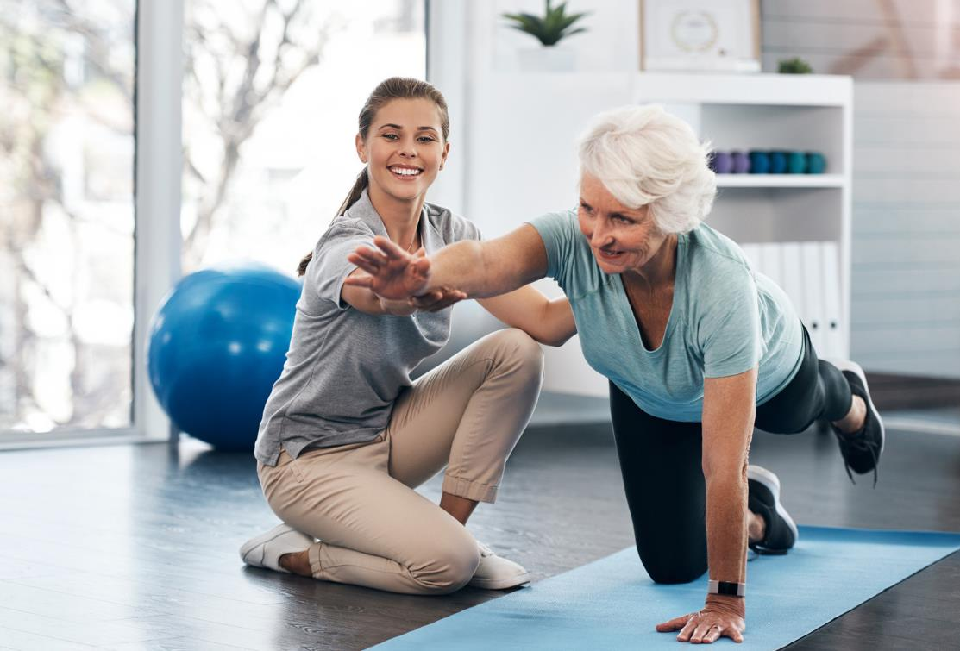
2. Physical Rehabilitation Therapist
PTs evaluate and treat to help restore function, reduce pain, prevent lasting disability and improve the ability to move. PTs work in many settings and with people of all ages.
A Physical Rehabilitation Therapist can insert lifestyle medicine easily in the daily work with patients as physical activity is one of the most important pillars of lifestyle medicine.
Chauvin N. Nerella - BioNeuro Klinika
biofeedbackneurofeedback.hu

Slide 6
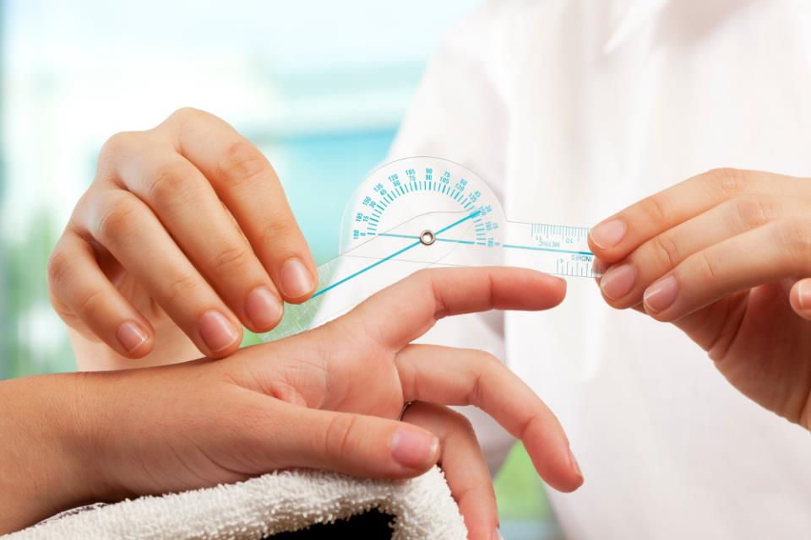
3. Hand Therapist
Assess and treat problems related to the hand, all the way through the entire upper extremity.
Therapy starts right after an injury or surgery,
To get back to their work or productive lifestyle as soon as possible.
Strongest connections with Lifestyle Medicine are the social factors, pain management and stress therapy.
Chauvin N. Nerella - BioNeuro Klinika
biofeedbackneurofeedback.hu

Slide 7
4. Driving and community mobility
Mobility is an essential part of our holistic view of patients. OTs in this field are focusing on the client's ability to be mobile in their community.
Teaching a patient new strategies to return to driving or maybe teaching a patient how to use a new form of public transportation.
Chauvin N. Nerella - BioNeuro Klinika
biofeedbackneurofeedback.hu

Slide 8
5. Environmental Modification
Work with patients, to modify or adapt their current environment, whether that's their home, school, work or community to maximize their occupational performance.
For example, determining the current environmental needs and either working with assisted devices, technology or adaptations to promote safety, independence, autonomy and accessibility in their lives.
Environmental modification therapists who specialize in this area, help make their patients safer and more independent in their current environment.
Chauvin N. Nerella - BioNeuro Klinika
biofeedbackneurofeedback.hu

Slide 9
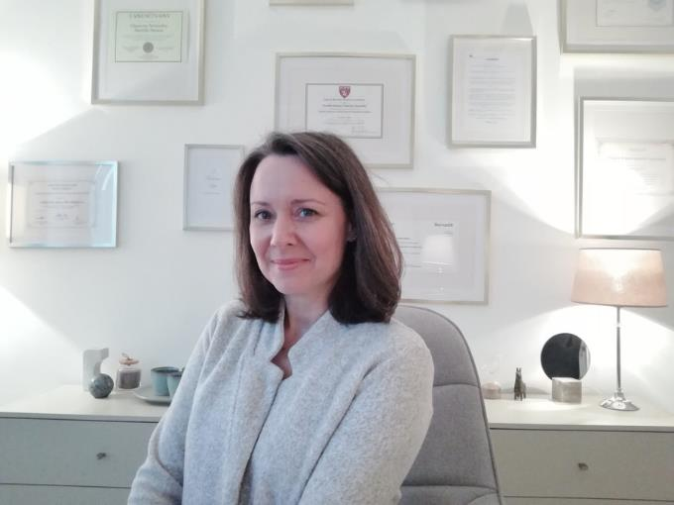
Thank you!
Merci !
Köszönöm!
Vielen Dank!
Chauvin N. Nerella - BioNeuro Klinika
www.biofeedbackneurofeedback.hu

