Slide 1
Pela Petraki Kavvadia, M.D., Greece Benno Krachler, M.D., PhD, Livsstilsmedicin Österåsen & Umeå University, Sweden
Internship in Lifestyle-medicine
- developing a curriculum
Notes:
Abstract for Budapest Elmo congress
1

Slide 2
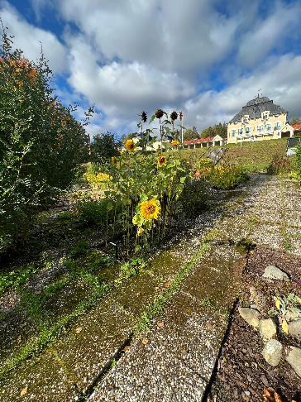
Internship (tentative arrangement)
Follow patient program (swedish):
Physical exercise sessions
Lectures (handout with translated slide-topics)
Meals & cooking lessons
Two (group-) sessions/week (english)
for interns only with mentor from relevant profession
Food & accomodation provided
No salary, no reimbursement of travel costs
Duration: 1-5 weeks (?)
Target group: Health professional / (senior) student

Slide 3
Conflict of Interest
My aim
- To offer Lifestyle Medicine clinical practice
- To advocate health-oriented care models (rather than disease-centered)

Slide 4
Residential settings allow for more intensive lifestyle interventions and thus have potential to reach patients with higher needs and lower levels of self-efficacy. Currently, only few clinics offer residential programs for intensive lifestyle interventions Europe-wide making it difficult for health professionals to gain clinical experience. Below, we describe the residential program at Livsstilsmedicin Österåsen (Sweden) and how we developed a preliminary model for internship. We share our experience of involving colleges in clinical work, overcoming language- and administrative barriers. The workshop is intended for both experienced colleagues who intend to offer similar internships and students/colleges interested in participating. Pela Petraki Kavvadia, M.D., Greece Benno Krachler, M.D., Medical Director, Livsstilsmedicin Österåsen; Associate Professor, Department of Public Health and Clinical Medicine, Sustainable Health, Umeå University, Umeå, Sweden
Internship in Lifestyle-medicine
- developing a curriculum
Notes:
Abstract for Budapest Elmo congress
4

Slide 5
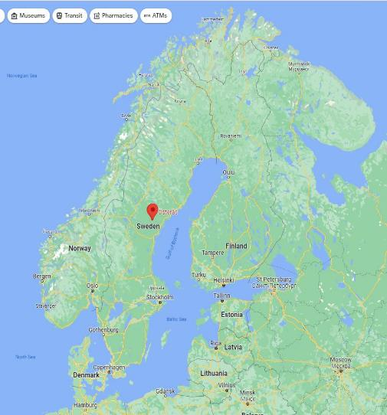
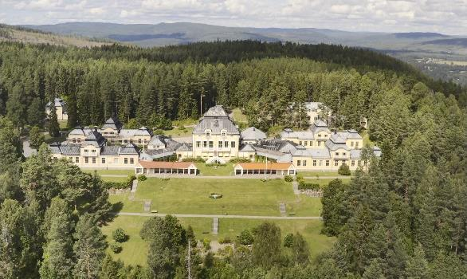
Österåsen Setting
1900 - ….
Notes:
Refer to the ice age 2000 bc Nipleden and Ångermanälven
5

Slide 6
Österåsen
- in the crossection of two eras
Sanatorium
Intensive Lifestyle Modifications clinic
Infectious diseases
NCDs
Weak role of patient in his Treatment
Strong role of patient in Treatment
Germ Theory
Anthropogens
Infection
Metaflammation
Behavior
Behavior

Slide 7
Intensive LS Modifications CLINIC
History, Architecture, Art, Environment
Health promotion in Community
Umeå University
Digital systems
Conferences/Courses for Healthcare providers

Slide 8
Multimodal intensive lifestyle intervention
Base week
5 days
diet / physical activity / stress management
Follow up
5 days
RAND-36
Referral
Clinical evaluation
1 day
Health survey, RAND-36
”Immersion”
18 days
Weight / pain / stress diabetes / tobacco / IBS
Follow up-survey:
RAND-36
”Run-in”
Goål <90 days
Preparation
Digitalt complement?
~ 5
weeks
~ 6 months
~ 18 months
9 intervention groups per year
(~ 45 patients/group)
Notes:
Patients program model in time intervention period
8

Slide 9
Multimodal intervention for patients with complex lifestyle-related issues - a simultaneous intervention to several systemic interrelated determinants of disease in vivo.
Notes:
Main groups if intervention
9

Slide 10
10
Notes:
Patient’s receiving intervention in their health pillars through a set of behavioral techniques sorted in the spectrum of BCT Taxonomy
10

Slide 11
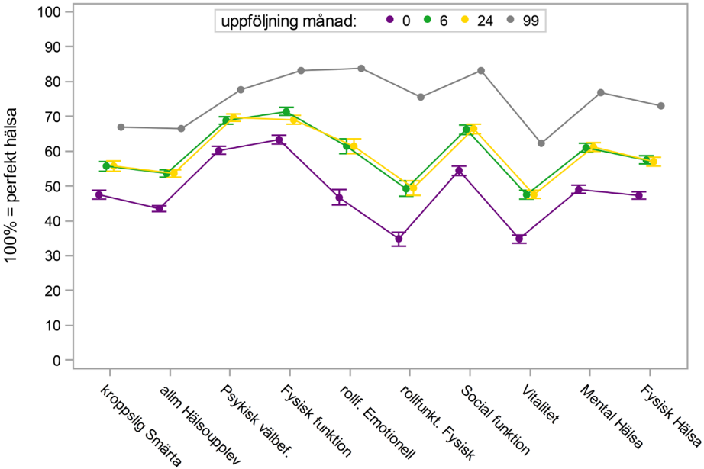
Changes in RAND-36 dimension: 2011-23
follow up month:
Normal population age 45-65
From treatment start to 6-month- and 2-year follow-up
www.rvn.se/osterasen
Notes:
Patient’s emotional and physical well being b4 and after intervention
11

Slide 12
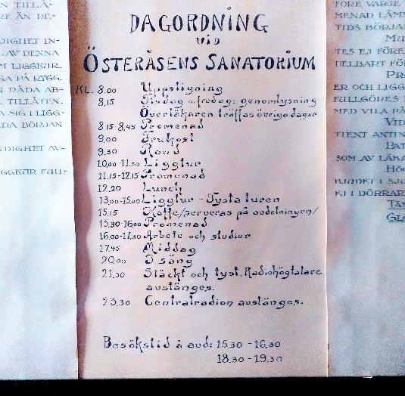
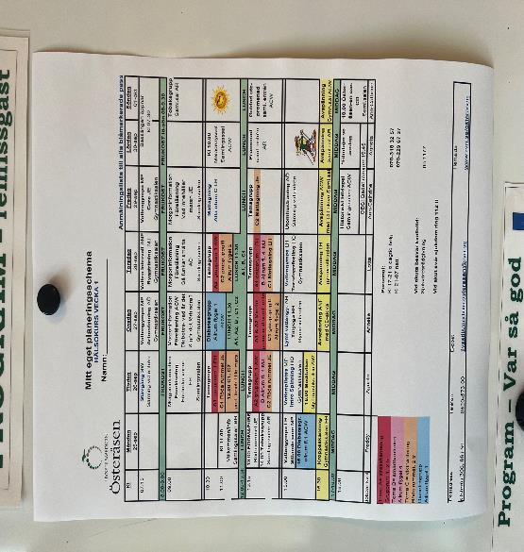

Slide 13
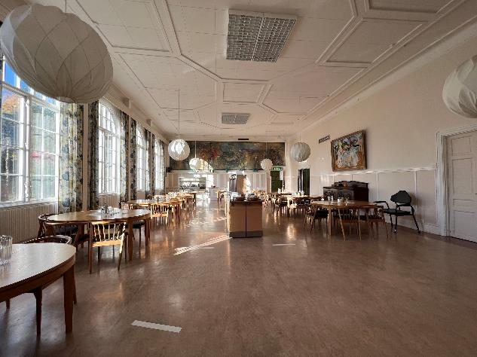
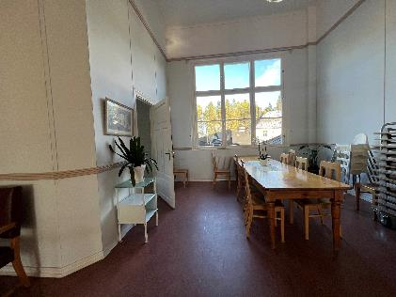
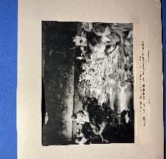
Nutrition Prescription

Slide 14
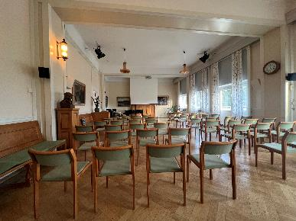
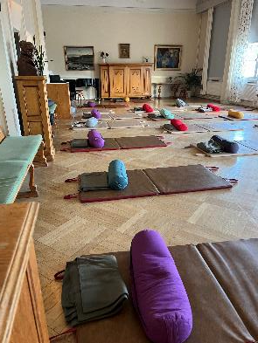
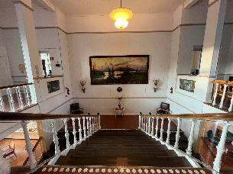
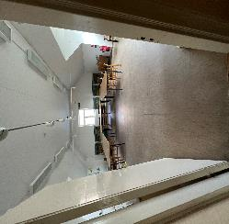
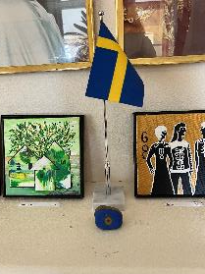
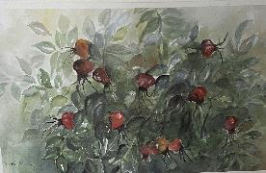
Health Literacy
Stress Management
Art Room
History
Culture

Slide 15
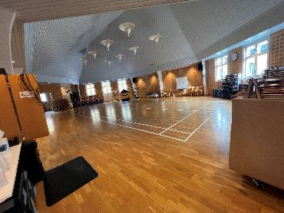
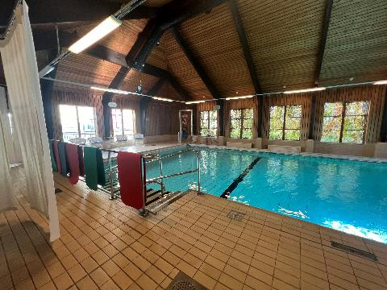
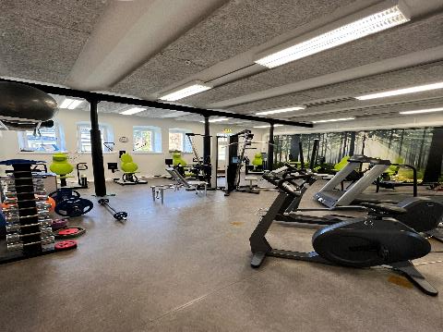
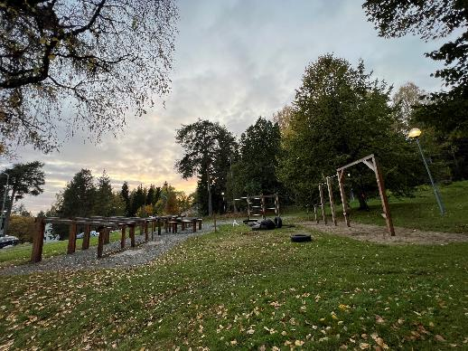
Physical Exercise Prescription

Slide 16
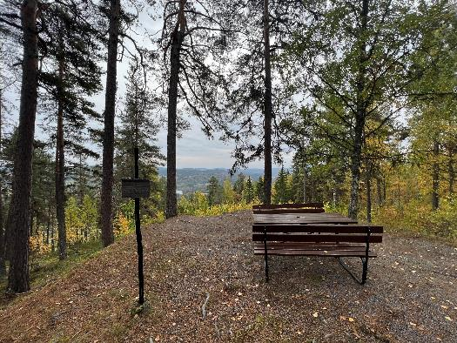
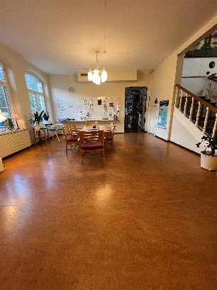
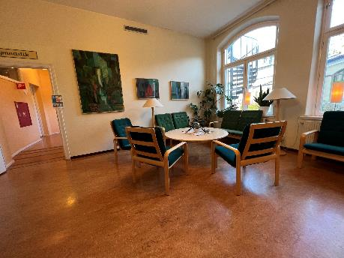
Social connection
-Indoor and outdoor sitting areas

Slide 17
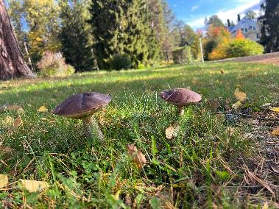
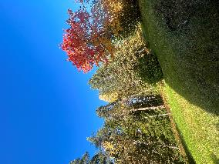
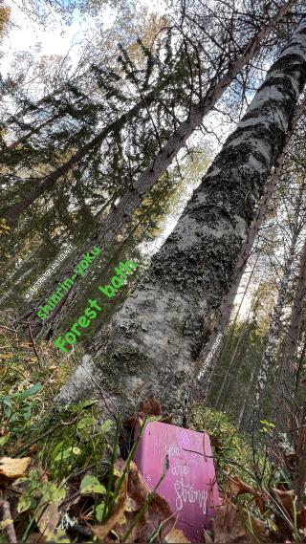
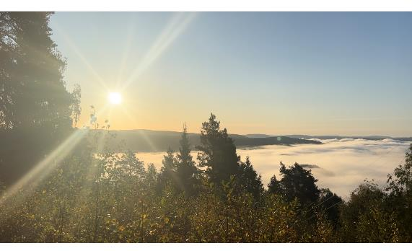
Nature prescription
-The power of Trees
Notes:
17

Slide 18
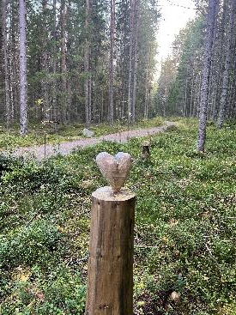
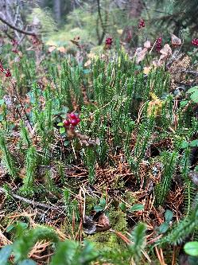
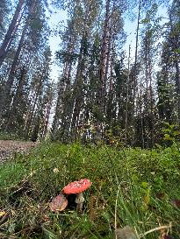
Notes:
Clinic’s surroundings is the ideal setting for connecting with nature, forest bath, bird sound healing and relaxing. Best season Automn
18

Slide 19
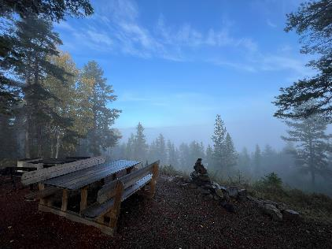
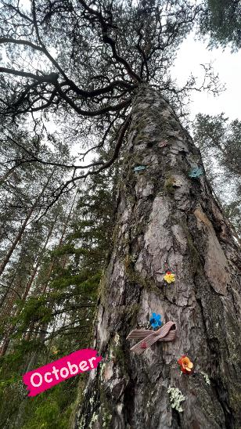
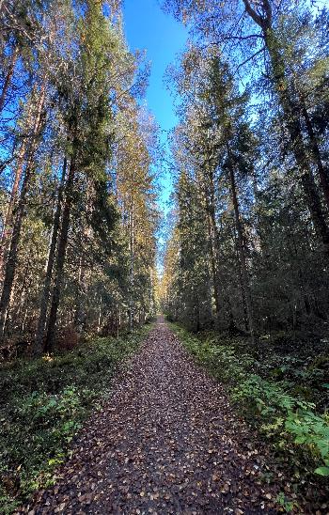
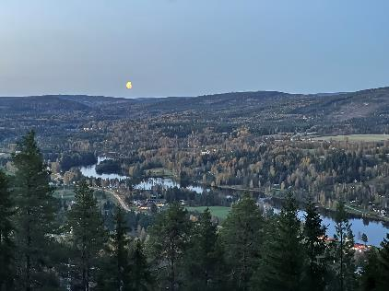

Slide 20
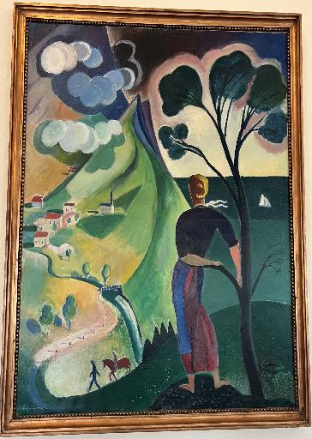
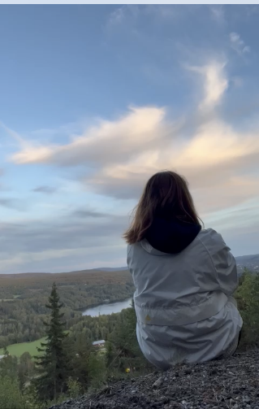
Egen Tid =Your own Time

Slide 21
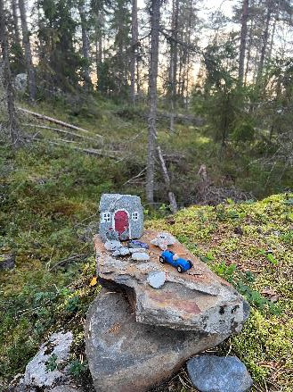
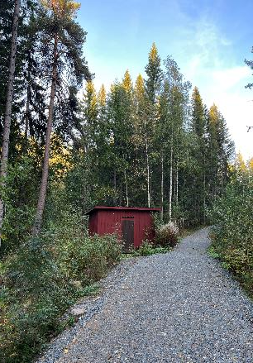
Sleep – Activities (incl meals) daily 07.15- 19.00

Slide 22
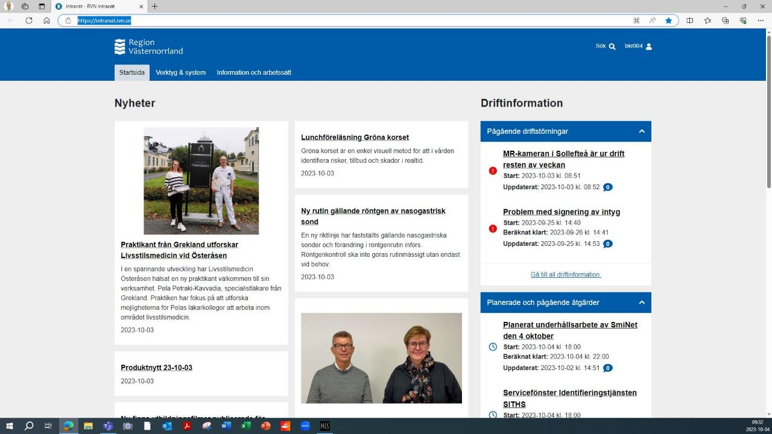

Slide 23
2023 September 11-October 7
2 different groups of patients (31-37 each )
Nutrition
,stress, relaxing,
physical exercise
, mindfulness,
diabetes ,
lymphedema,
chronic pain,
nicotine and alcohol control
Nutrition
Health
Literacy
Meals( 3 X day)
Meal preparations(3):
Vegetarian Scandinavian plant-based cuisine
Fodmap
Environment
Social Connection
33
14
Daily 07.15-18.00
(H)ITLSC
ILCT
Physical exercise
SMA
Shared medical appointments
Gym indoor outdoor
Water gym
Guided forest walking
High Intensity Lifestyle Change
Diabetes
low FODMAP,
tobacco cessation (5)
Stress (6)
30
13
Intensive Lifestyle Change Treatment
Stress management
Extras:
-LSM& Community
-SK Course
- Culture& History
SK course= 5day training course in LSM for doctors in Swedish
LSM & Community= health promotion weekend open for community
19
1 basic week
1 SK course week
2 Emersion weeks

Slide 24
Model of Pedagogy source: Lifestyle Medicine, Garry Egger 3rd ed.
Knowledge
The Science
Evidence based and nationally recognized practice guidelines
The skills
The Art
Diagnosis, Prescription, De-prescription
Tools
Materials and Ways
Conventional tools, mHealth, digital Health
Procedures
Actions
e.g. Programs, SMAs, Self-management training

Slide 25
General Competencies for practice of LSM (ELMO)
2 Leadership skills
1.Promote healthy Lifestyle
2. Practice a healthy lifestyle
2 Knowledge skills
1.LSM positively affect health outcomes
2.Demonstrate ways by which physicians can affect behavioural change
3 Assessment skills
1.Of predispositions
2.Readiness to change
3.Perform History taking
4.Perform Physical examination
4 Management skills
1. Use of National Guidelines
2. Establish effective patient Doctor relationship
3. Collaboration with patient’s system and environment
4. Help patients by also referring to other specialists
4 Community support skills
1. Practice interdisciplinary and in community teams
2. Apply supportive office and tech systems
3. Measure process and outcomes
4. Use appropriate community referral resources to support implementation of healthy lifestyles

Slide 26
Resident-Patient Relationship: Living the patient’s experience:Processing and analysis of Curriculum Competency
Immersion in Environment Outdoor Indoor
2 Experts-1 Coach
Observation
Empathy
Empathy
Active participation
Humility
Boarding setting for patient and resident
Healthcare provider’s self care
Language as inhibitor and advantage
Healthcare provider as role model
Notes:
Within personal subjectivity
26

Slide 27
Environment indoor outdoor
Boarding set
Open mind,
No expectation mindset
Non-judgmental-prejudiced attitude
Curiosity
Positivity and
Exploration spirit
Observation
Language Barrier
Immersion
Patients
Knowledge
Reflection of Resident on himself
Notes:
Nonverbal all senses information flow constantly of
-one’s body language and facial expressions
-patient logistics grouped for weight loss, stress management and chronic pain management, with needs on diabetes, IBS care and assistance in quitting substances(nicotine and alcohol)
The patient follow an extensive planned exposure of health literacy
Input on the patient's compliance efficacy and motivation for routine classes and repetitions, the interaction with the healthcare providers on scheduled activities, the eating times, the relaxed time and the level of change as days go by.
The resident living the experience of the patient sets himself apart from the conventional residence “one expert” practice- out of the white coat status position and metaphorically” wears the shoes of the patient” or “take the same drug treatment”.
The resident himself immerses in a state of self care and self management, realizes need of personal lifestyle improvements and sets personal healthy lifestyle habits that also serve his healthy role model position
Environment sets the working ground of healthcare team with patients:
INDOOR
quiet,safe,tech-free,noise free,comfortable,friendly,historical,cultural,organized, providing both independency and socially inviting, perfume allergy-free, user friendly, encouraging self care. Health care providers’ teamwork that reflect positive psychology, patience and openness while at the same time setting boundaries.
The facilities support all types of Ph.activity/exercise, educational meal preparations and multimodal patient sitting areas, as long as rooms of small and big groups gatherings
OUTDOOR
Natural environment in a forest with clean air, lots of safe space - vehicle free area for all walking types in a distance range of 3,5 km on an altitude where you admire from above the banks of the river Ångermanälven
27

Slide 28
In Österåsen Resident follows the interdisciplinary intervention on all pillars of health
Experience the implementation of
multiple SMART prescriptions
Health Literacy,
Self Care
Self management skills
Active participation
Active Participation
Performing a Diagnosis
Counseling
LSM prescription and medication De-prescription
Barrier
Sexual health
Councelling as:Motivational interviewing
Sleep Hygiene
Sexual health
Sleep Hygiene
Motivational interviewing

Slide 29
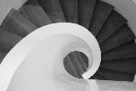
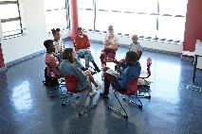
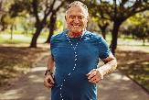
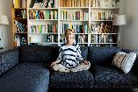
Patients and Healthcare providers as active participants in self care
Humility
Acceptance
Empathy
Compassion
2Experts 1 Coach
Engaging
Empathy
Healthcare provider as Role model
Nature prescription
-The power of Trees
SMAs
Resident-Patient’s Small talks
Healthcare provider’s selfcare
How healers heal
Notes:
Relaxed inspired, nature aware, plantbased diet, digital noise&pollution detox, mindful, forest bath,
29

Slide 30
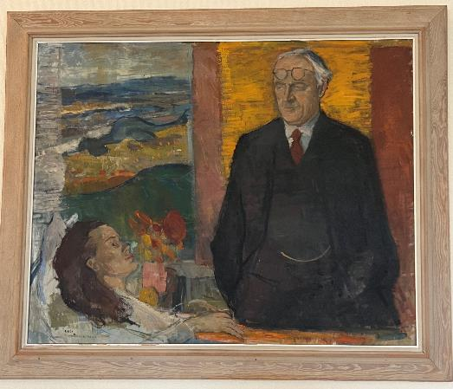
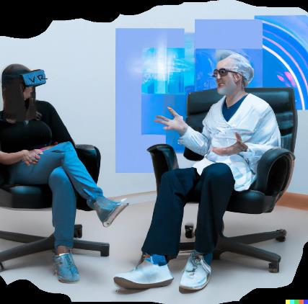
The Doctor patient model
a
in the times of Communicable Diseases and – probably (not) in the era of Non-Communicable diseases
Mindset
Kjell Rosen’s portait of Helge Dahlstedt, senior consultant of Österåsen Sanatorium 1919-1951
AI’s DALL-E’s generated picture with the description ”Patient and Doctor of Lifestyle Medicine in the era of Virtual Reality”

Slide 31
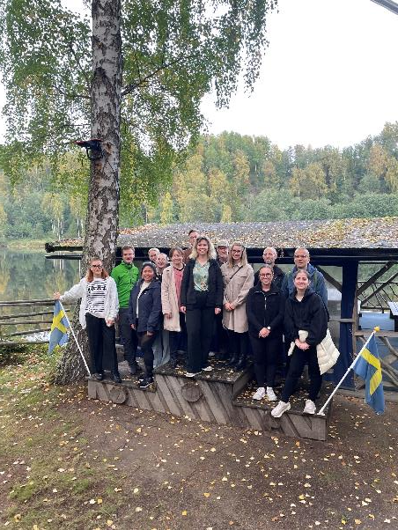
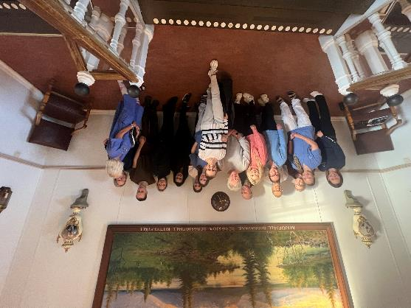
Team
Tack så mychet
Inspired, connected and with more tools

